Slide 1
Science with Dr. Christina Rahm We will get started shortly.

Slide 2
Medical Disclaimer:
The information provided is for educational purposes and is not intended as medical advice, or a substitute for the medical advice of a physician or other qualified health care professional. You should not use this information for diagnosing a health or fitness problem or disease. You should always consult with a doctor or other health care professional for medical advice or information about diagnosis and treatment.
Notes:
The information provided is for educational purposes and is not intended as medical advice, or a substitute for the medical advice of a physician or other qualified health care professional. We do not aim to diagnose, treat, cure or prevent any illness or disease. You should always consult with a doctor or other health care professional for medical advice or information about diagnosis and treatment. The information in this presentation has not been evaluated by the Food & Drug Administration or any other medical body.

Slide 3
Dr. Dori Naerbo, Ph.D.
Notes:
Good morning, good afternoon, good evening…wherever you are in the world this is Dr. Dori Naerbo and I am your host on today’s call. For those of you who do not know me…I am a clinical researcher and author of several books.

Slide 4
Dr. Tina Božičnik

Slide 5
Medical Disclaimer:
The information provided is for educational purposes and is not intended as medical advice, or a substitute for the medical advice of a physician or other qualified health care professional. This is for science and educational purposes only and cannot be used in any aspect for sales or marketing. You should not use this information for diagnosing a health or fitness problem or disease. You should always consult with a doctor or other health care professional for medical advice or information about diagnosis and treatment. This is Confidential. Do not distribute—for scientific educational purposes only.
Notes:
The information provided is for educational purposes and is not intended as medical advice, or a substitute for the medical advice of a physician or other qualified health care professional. This is for science and educational purposes only and cannot be used in any aspect for sales or marketing. You should not use this information for diagnosing a health or fitness problem or disease. You should always consult with a doctor or other health care professional for medical advice or information about diagnosis and treatment. This is Confidential. Do not distribute—for scientific educational purposes only.

Slide 6
ISNS Case Study Presented by: Dr. Tina Božičnik

Slide 7
Eczema
Eczema, or atopic dermatitis, is a very common chronic skin disease that can develop during childhood, adolescence, or adulthood, and it can range from mild to severe. It is so common that 31 million Americans have some form of eczema. Usually, it affects children the most, and in many cases, it can disappear with age. The exact cause of eczema is still not determined, but researchers believe it arises from interactions between genes and environmental triggers.
The symptoms include the following: itching, dry or sensitive skin, inflamed skin, rough or scaly patches of skin, discolored skin, oozing or crusting, and areas of swelling. In babies, eczema mainly appears on the cheeks and the outer surfaces of the arms and legs and – less commonly – on the back, tummy and chest. Children, teenagers and adults who have eczema are most commonly affected on the backs of their knees, the insides of their elbows and the back of the neck. The itchy rash may also develop on the palms of their hands and soles of their feet. It rarely affects the face.

Slide 8
AFFECTED AREAS

Slide 9
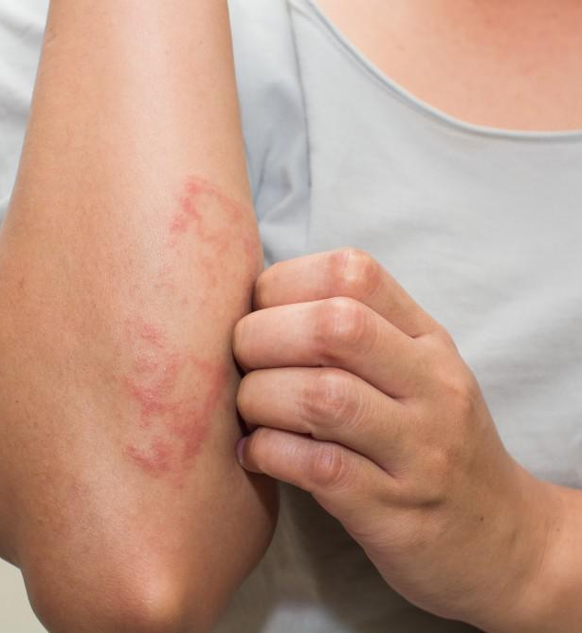
ECZEMA DIAGNOSIS & TREATMENT
Currently, there is no cure for eczema, but there are ways to prevent flare ups and treatments to manage it. To prevent flare ups, avoid allergens, change dietary habits, moisturize the skin, avoid stress and anxiety, heavy sweating, or certain scents or fabrics. Treatments for eczema, depending on age and severity, include over-the-counter (OTC) remedies, topical medication, phototherapy, immunosuppressants, and biologic drugs. If not treated properly, bacteria can sometimes cause infection to the skin. Many people look for alternative treatments such as herbal products or dietary supplements to manage this disease, but there has not been enough research to prove its efficacy.

Slide 10
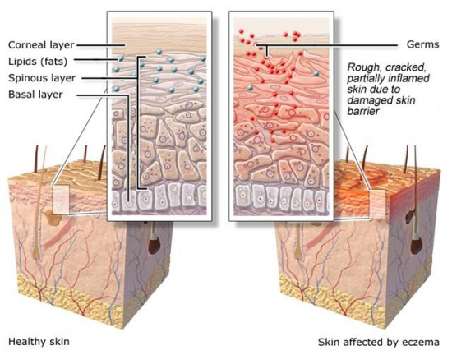
CAUSES
Our skin is made up of an outer layer (epidermis), a middle layer (dermis) and an inner layer (subcutaneous layer). This outer layer has different layers too: the basal layer, the spinous or prickle-cell layer, and the corneal or horny layer (enlarged in the diagram below). The corneal layer – the visible part of the skin – protects the body from germs. It renews itself constantly as new cells grow from the basal layer.
In people with eczema, the corneal layer doesn't provide enough protection because it is damaged by the inflammatory response occurring in the skin. Another possible cause is a mutated gene that affects the production of the protein filaggrin, which the body needs to make the skin's outer layer. Because there isn't enough filaggrin, the balance of fats in the skin changes, causing the skin to lose a lot of moisture.

Slide 11
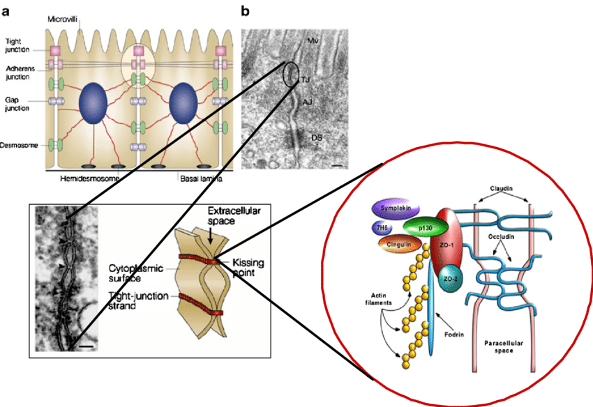
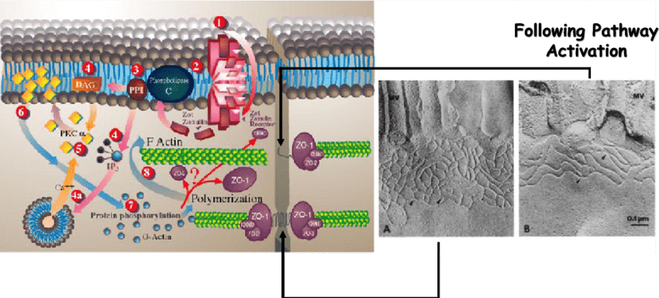
WHY THIS HAPPENS?
LEAKY GUT

Slide 12
NEUROLOGICAL COMPONENT Brain displacement- RIGHT BRAIN DEFICIENCY- VERY ANGRY CHILDREN USUALLY VERY SENSORY OVERLY REACTIVE!!

Slide 13
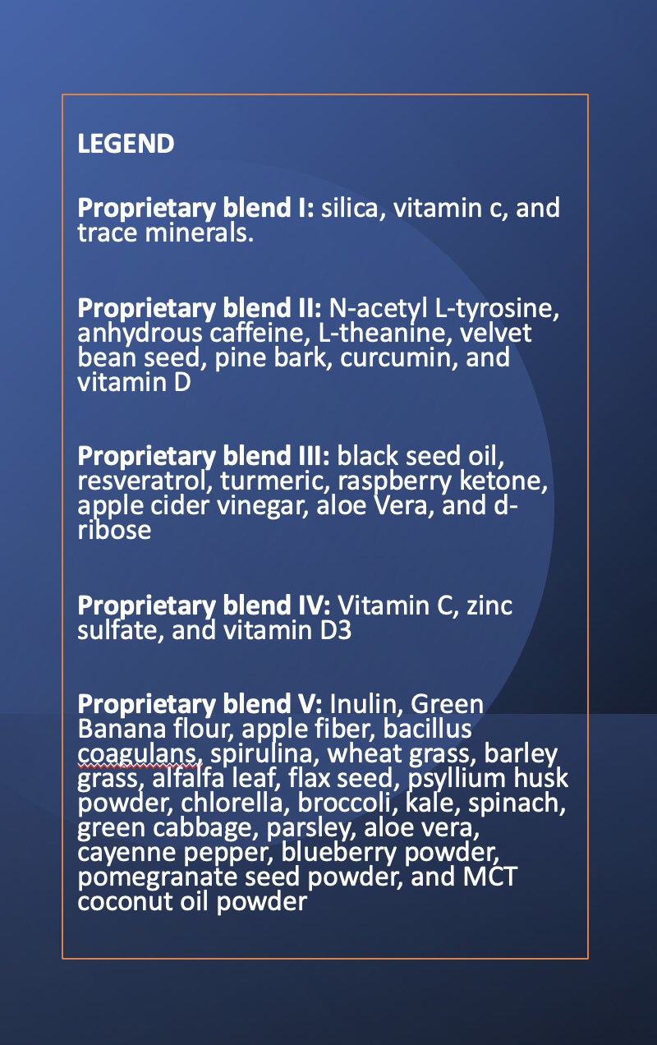
PROPRIETARY BLENDS LEGEND

Slide 14
ISNS CASE STUDY I
Patient: Male
Age: 13-Month-Old
History: In July 2021 we started the treatment 13 month old baby boy. He had severe eczema. He was put on corticosteroids, which, according to his mother only worsened the situation. He wasn’t sleeping, scratching all day long. Hi skin was red, dry, severely inflamed. Nothing had helped. He has been put on a very severe diet due to multiple known severe allergies.
Here are some before pictures on the upcoming slides.

Slide 15
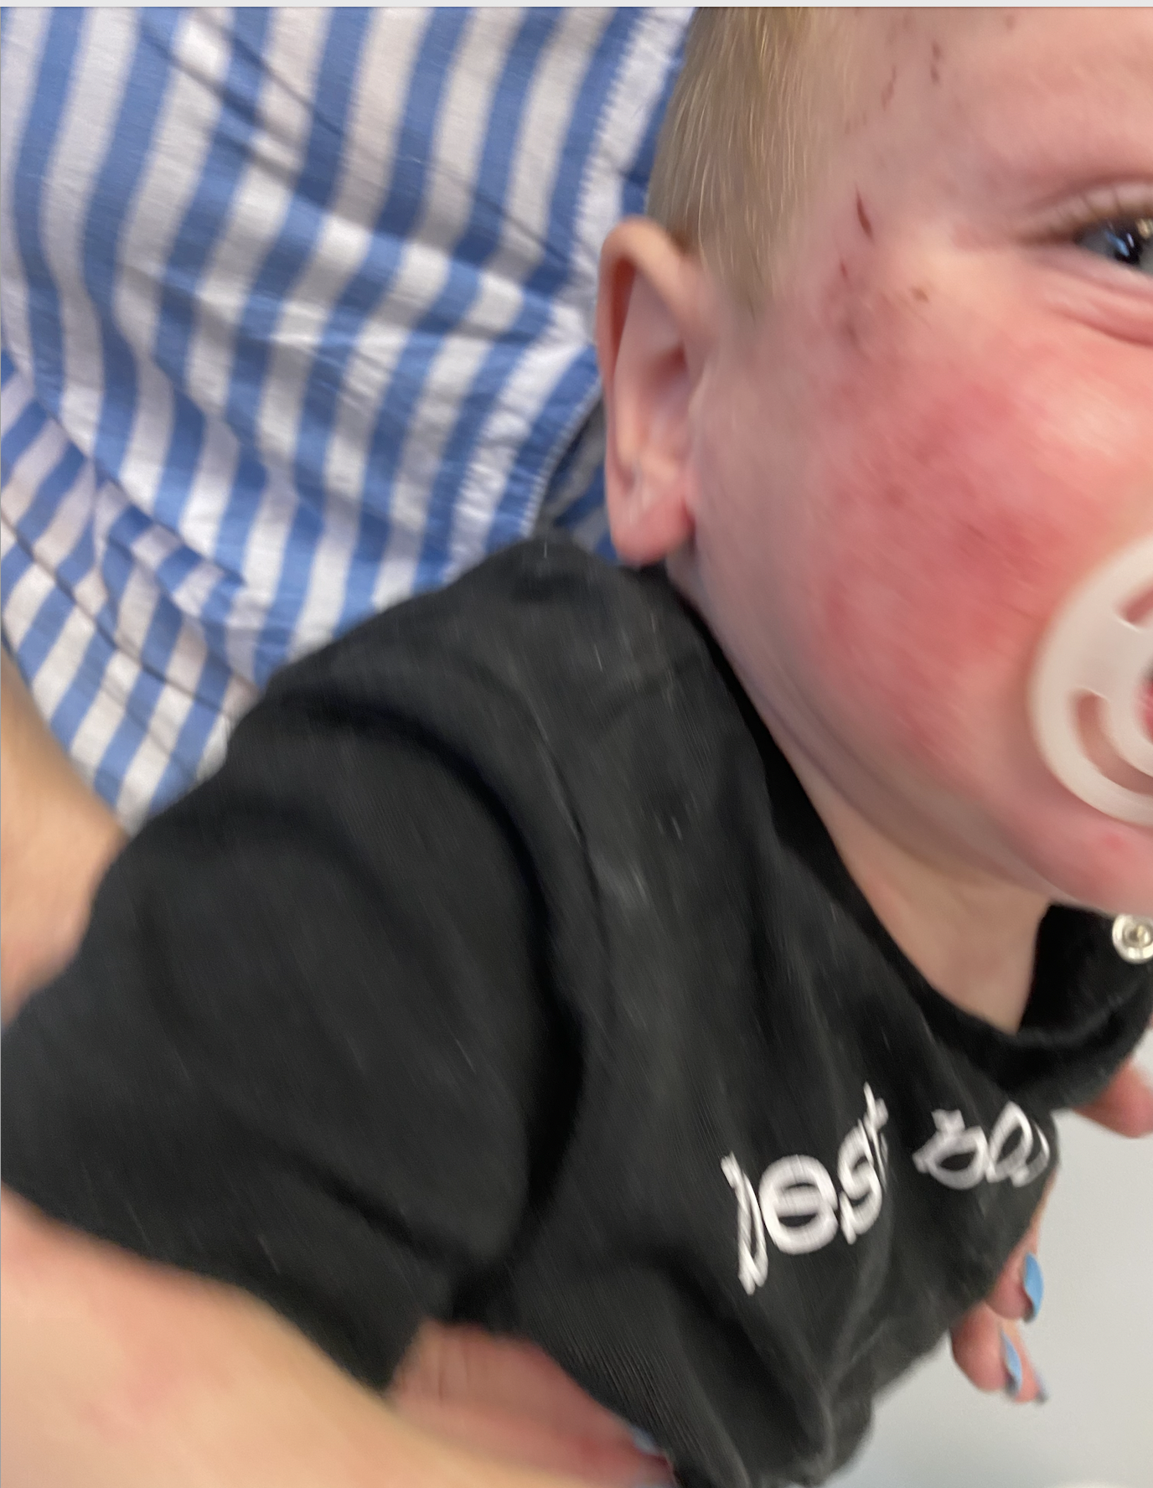
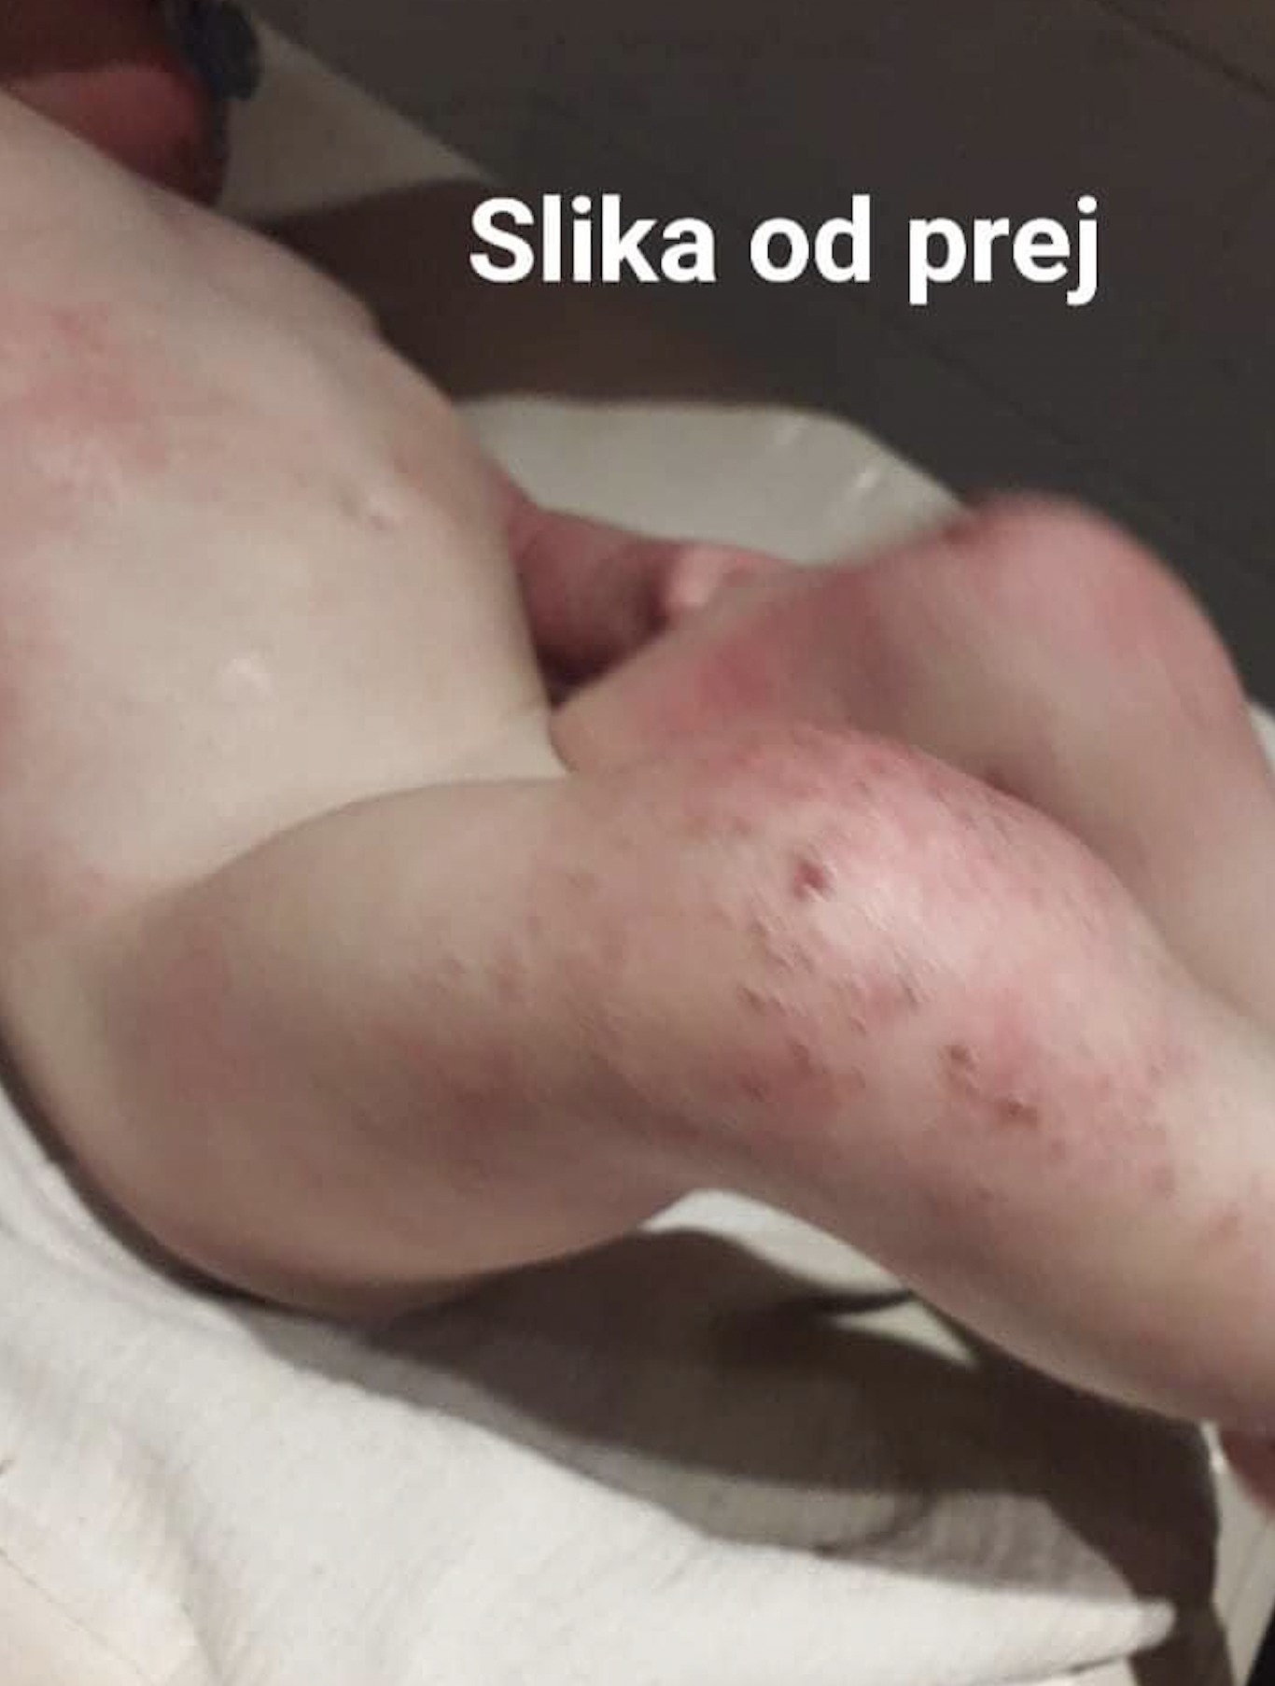
Before treatment

Slide 16
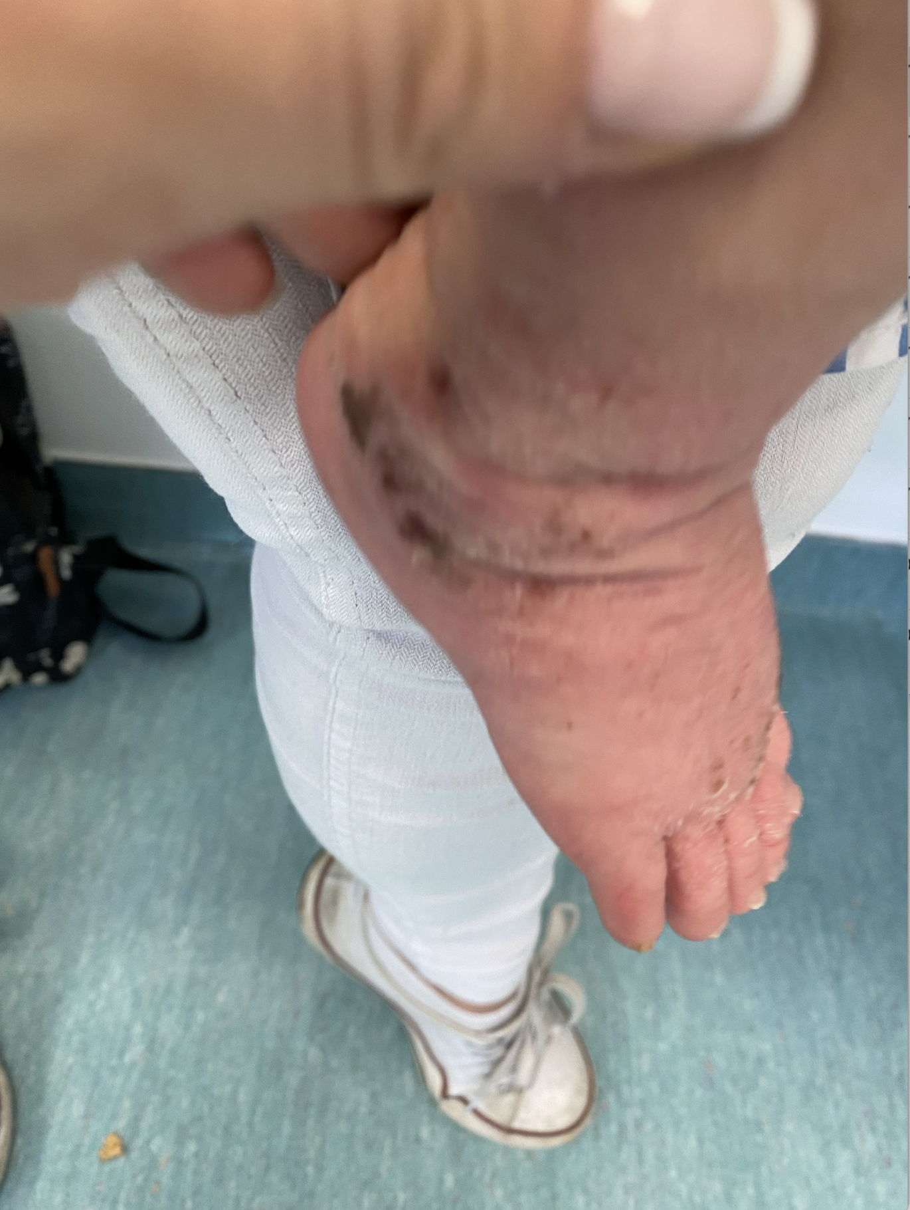
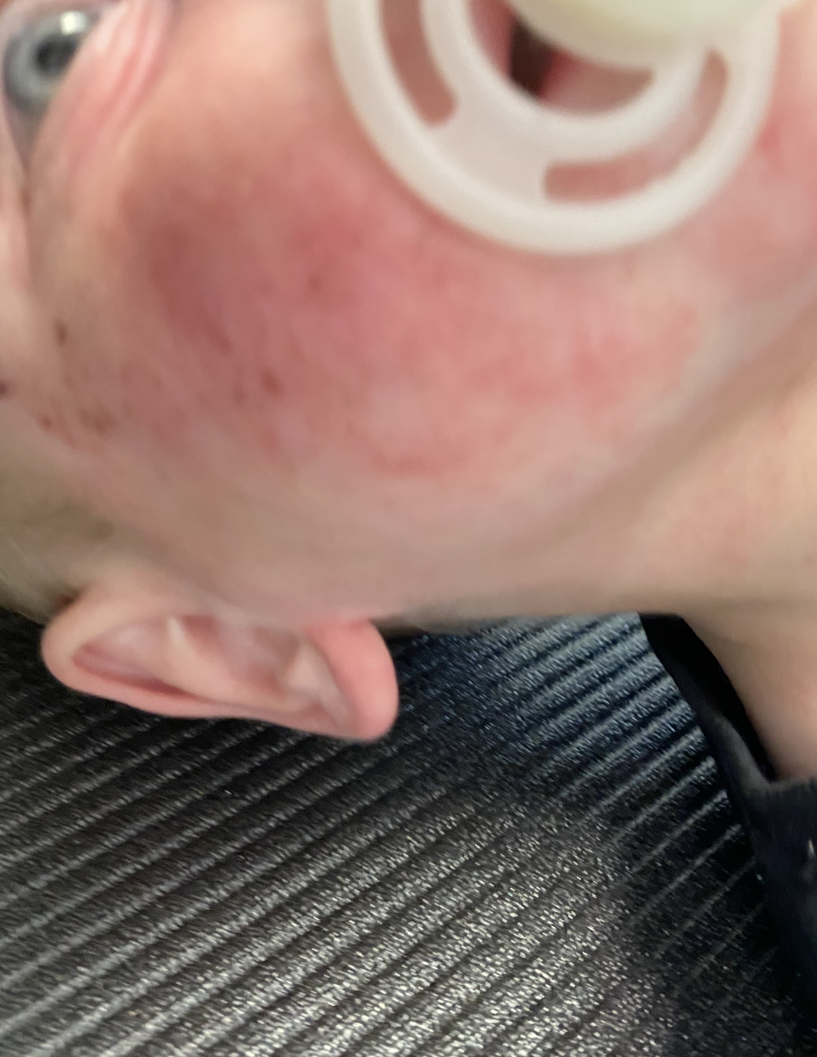
Before treatment

Slide 17
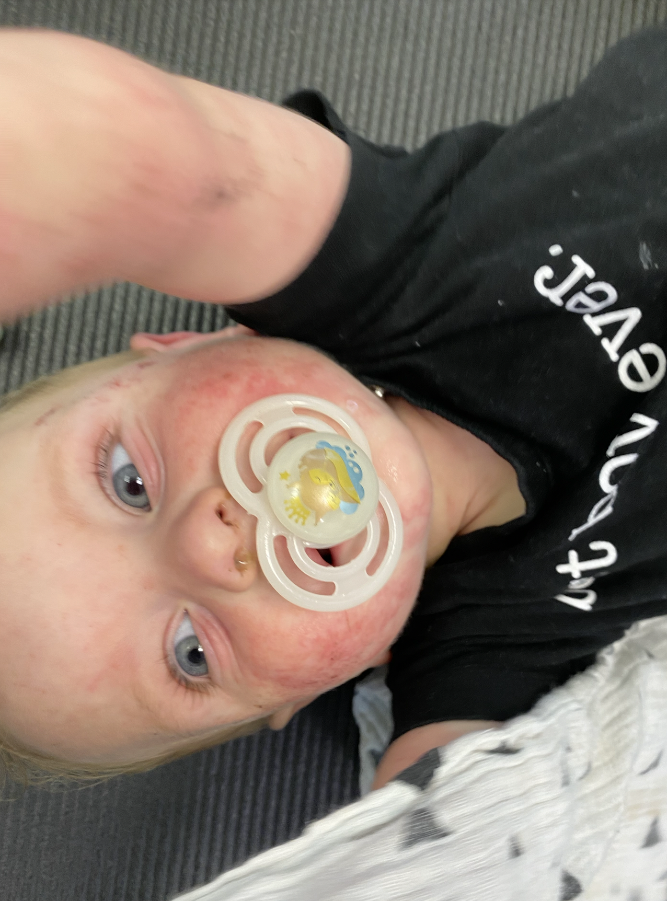
Before treatment

Slide 18
Treatment Plan
The first of the 4 R’s involves removing any allergenic foods, chemical irritants, medications or pathogenic microorganisms which may be causing gut inflammation. We excluded potential foods that have caused leaky gut and haven’t been yet excluded AND replaced them with foods that his body tolerated to replace the potential missing vitamins, minerals, etc.
The second R – replace – consists of adding back and replacing anything that will aid in normal digestion or might be lacking because of your poor digestive health. For example we need adequate amounts of hydrochloric acid and digestive enzymes to break down and extract the nutrients from our food. All the micronutrients missing due to the leaky gut need to be replaced!! ( Besides multiple vitamins, trace minerals, Several Varieties of probiotics, Several forms of anti inflammatory agents, we added proprietary blend No1 and No2. We started with small amount 2 drops of PB 1 BID and 3 teaspoons of PB 2 daily, PB 2 was added to daily skincare routine that consisted of detox and skin microbioma restoring and nourishing daily baths, hydrating and skin microbioma restoring cremes including several natural healing compounds, Floral Essences were added to the treatment)

Slide 19
Treatment Plan (Continued)
With that said I already explained the third part of treatment which is R – re-inoculate – involves reintroducing good bacteria or probiotics into the gut to establish a balanced gut flora. We need to reestablish a normal terrain or microbiome.
Lastly, the fourth R – repair – consists of taking specific nutrients which help support and nurture a normal gut lining.
THE IDEA IS NIT JUST TO REMOVE BUT TO FEED THE CELLS OF MISSING COMPOUNDS AND RESTORING THEIR HEALTH. The magic is to be able to reintroduce the foods and the body doesn’t develop a negative reaction.
After the Stool test was done, we treated accordingly and added GI Support supplements, We added Broad spectrum herbal formulae, Herbal Immune System and Biofilm regulators, Several GUT lining restoration supplements.
(Next images are results TWO MONTHS – SIX MONTHS into the treatment)

Slide 20
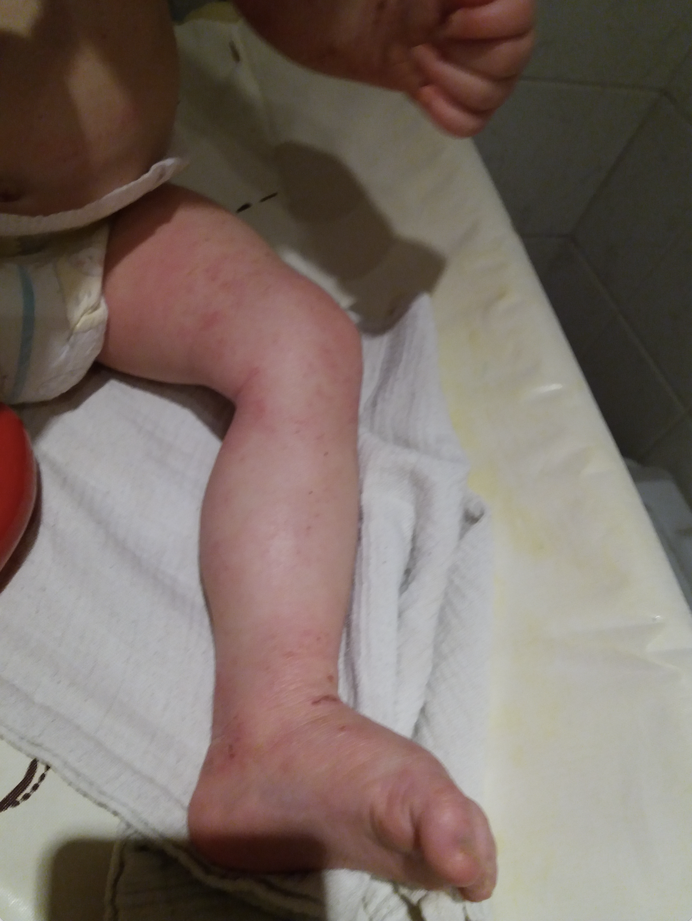
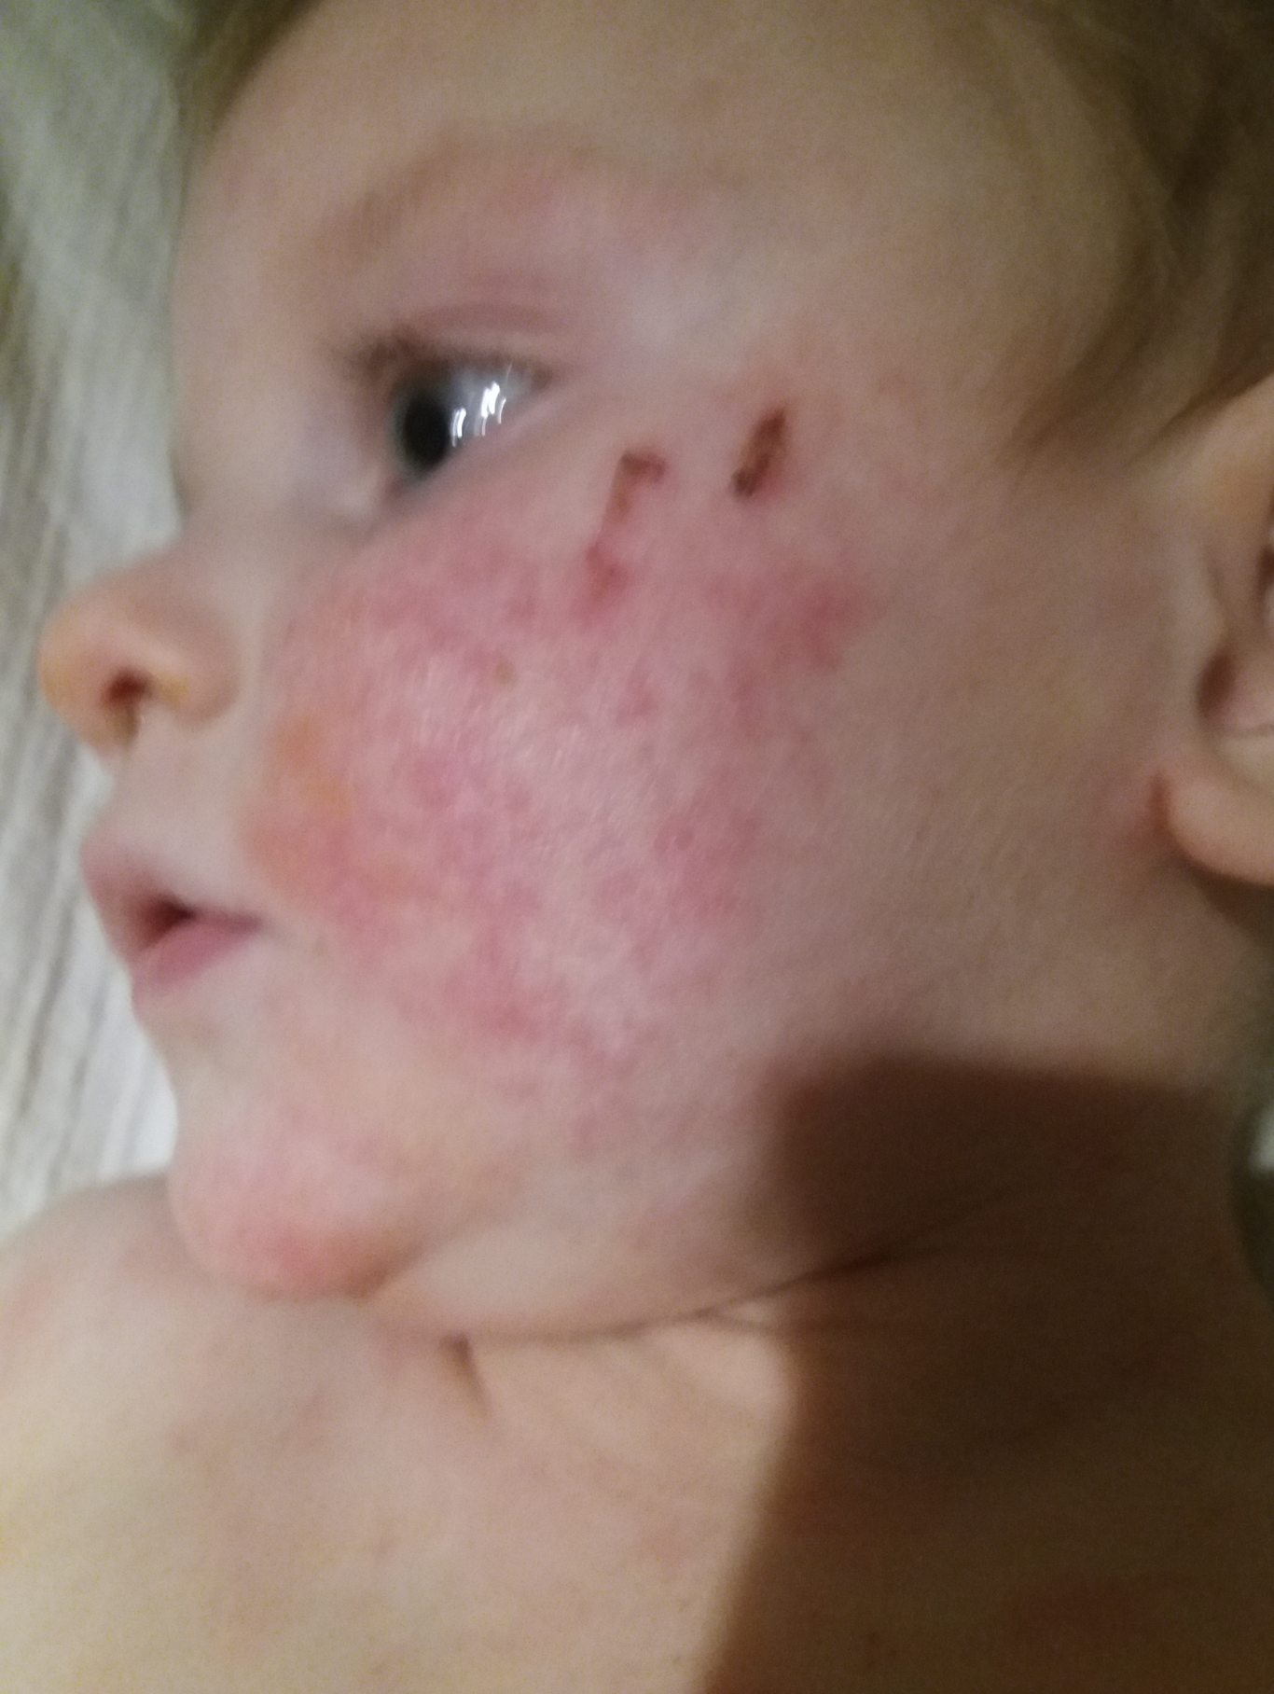
TWO MONTHS into treatment

Slide 21
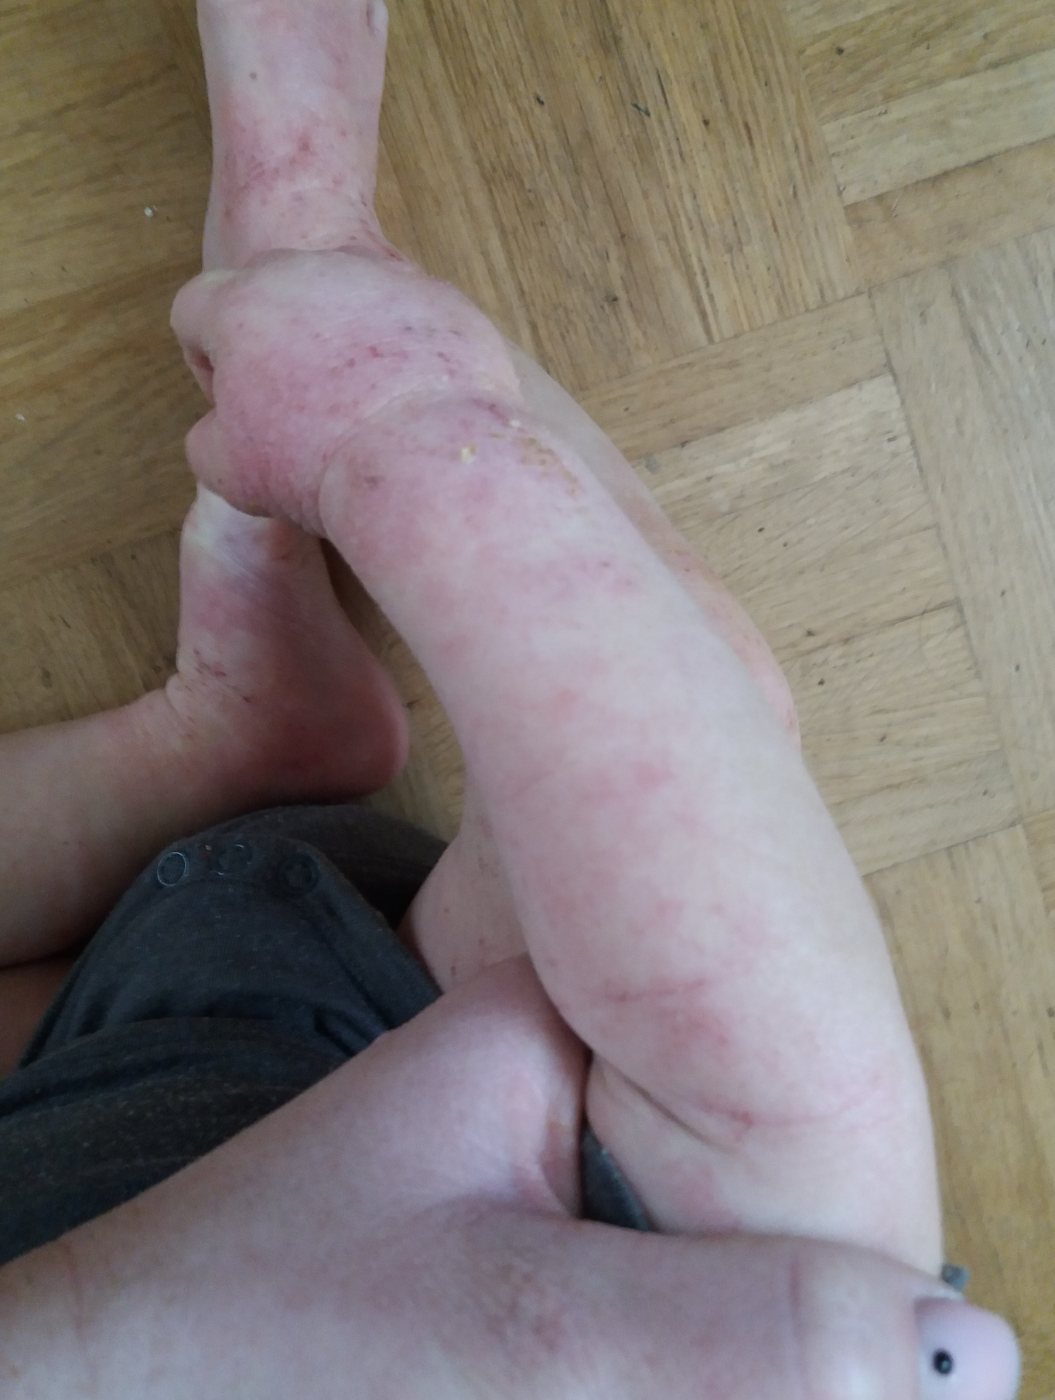
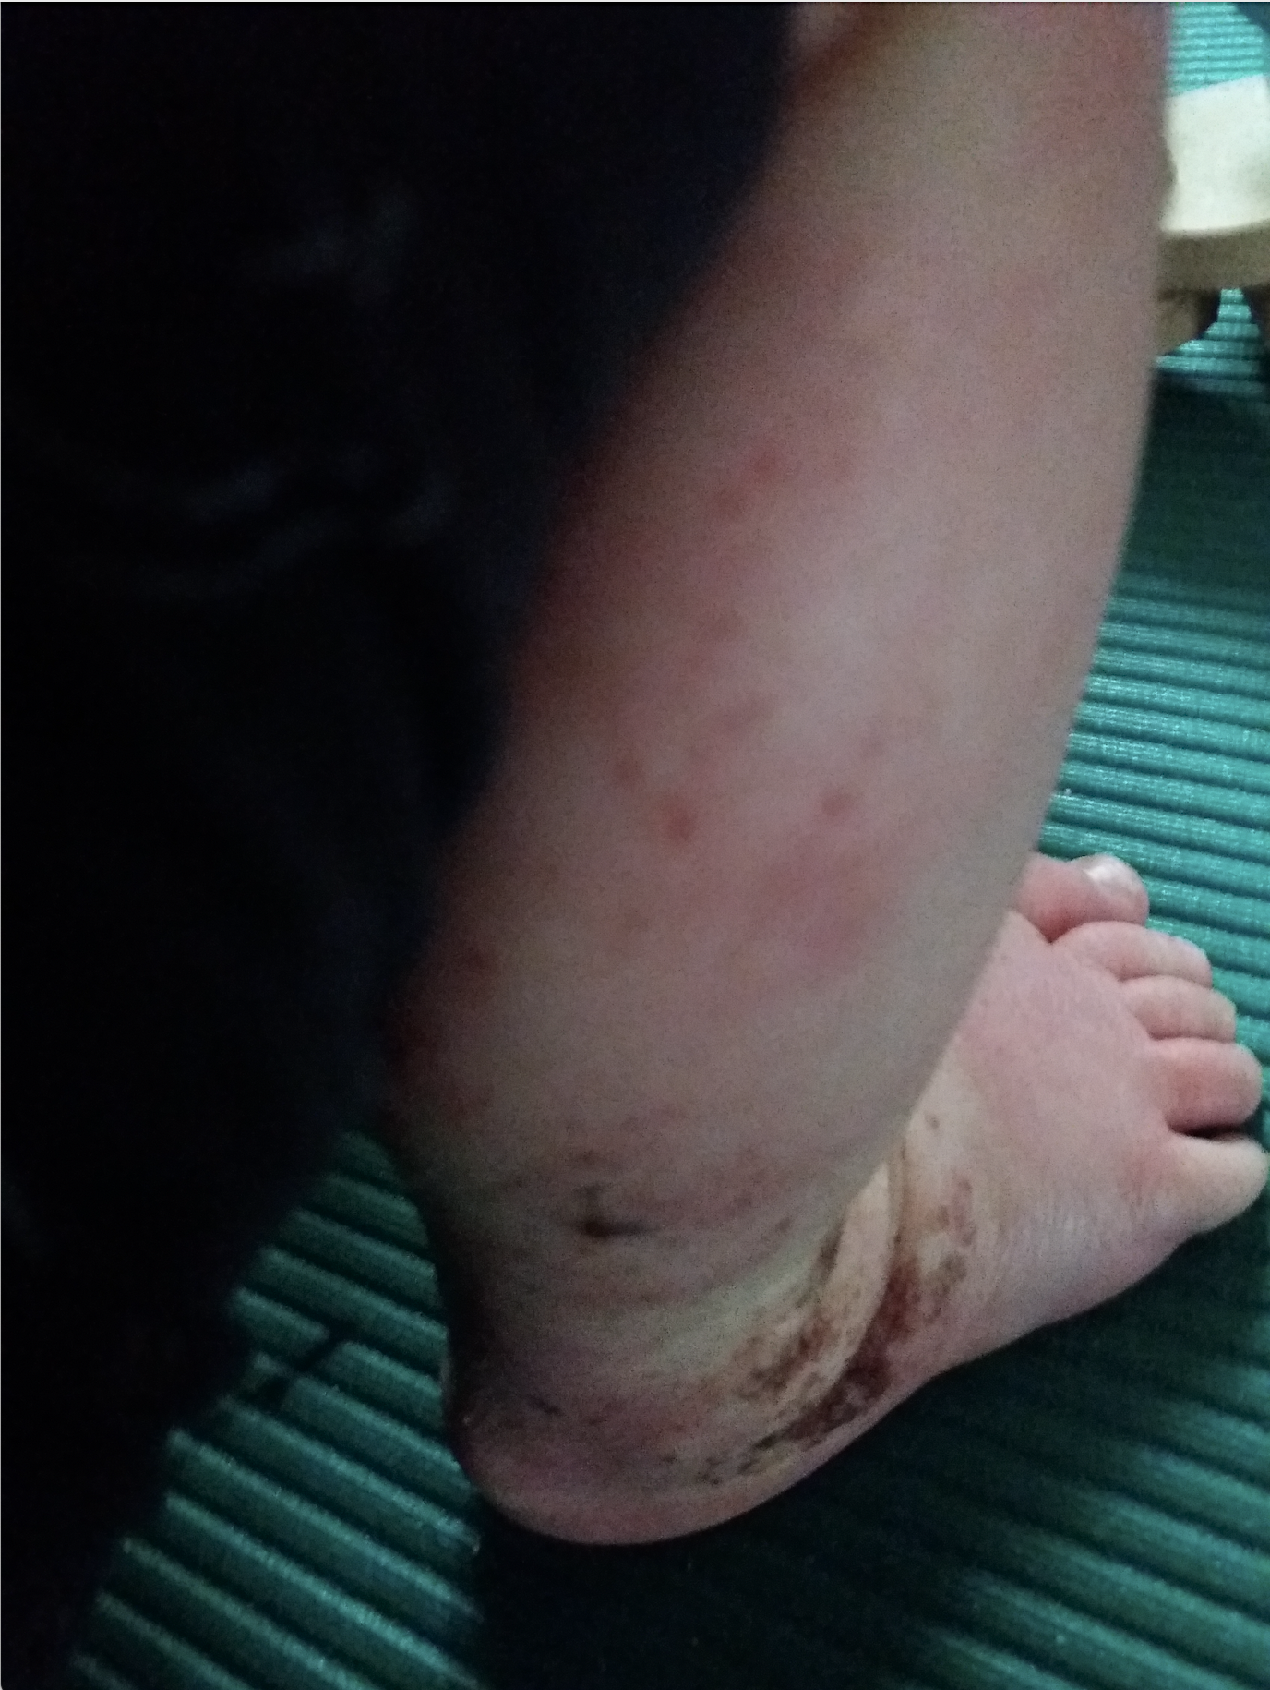
TWO MONTHS into treatment

Slide 22
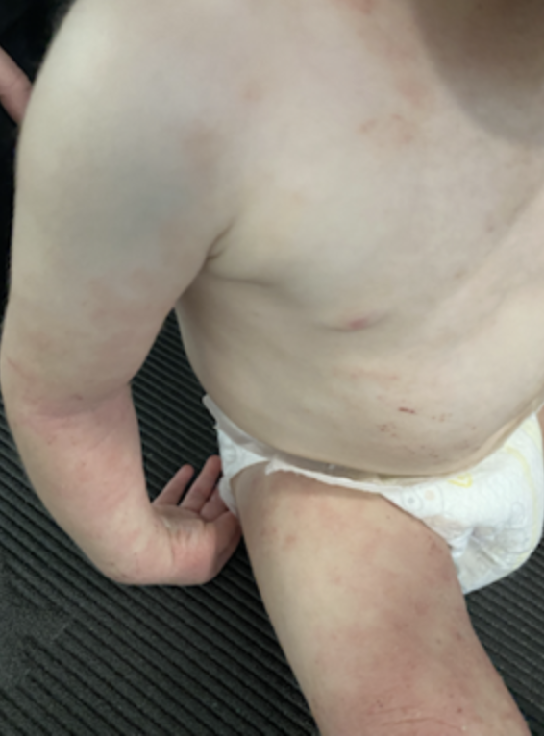
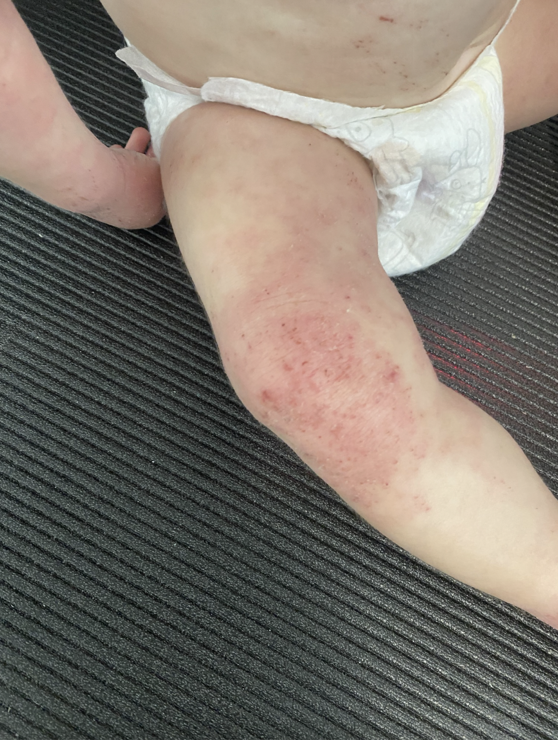
FOUR MONTHS into Treatment

Slide 23
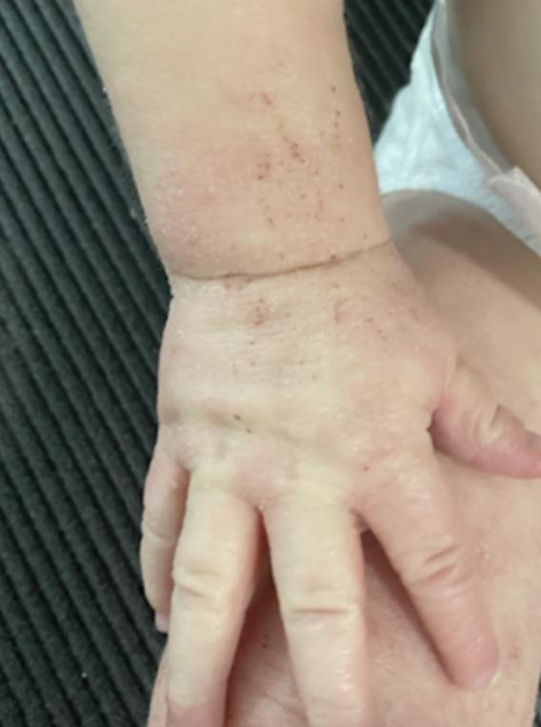
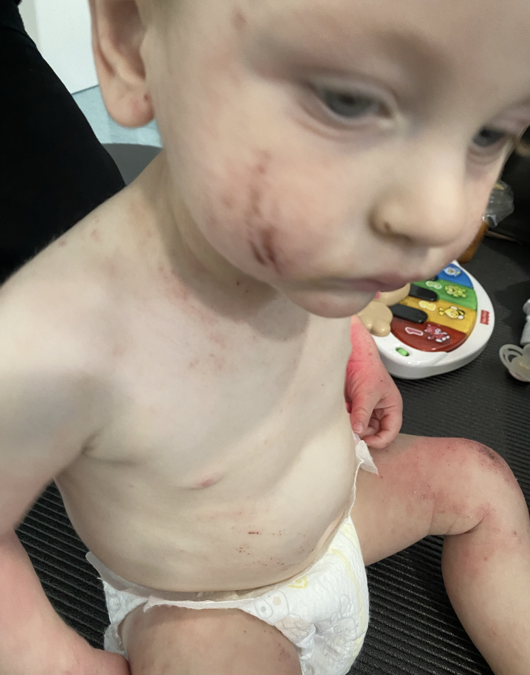
FOUR MONTHS into Treatment

Slide 24
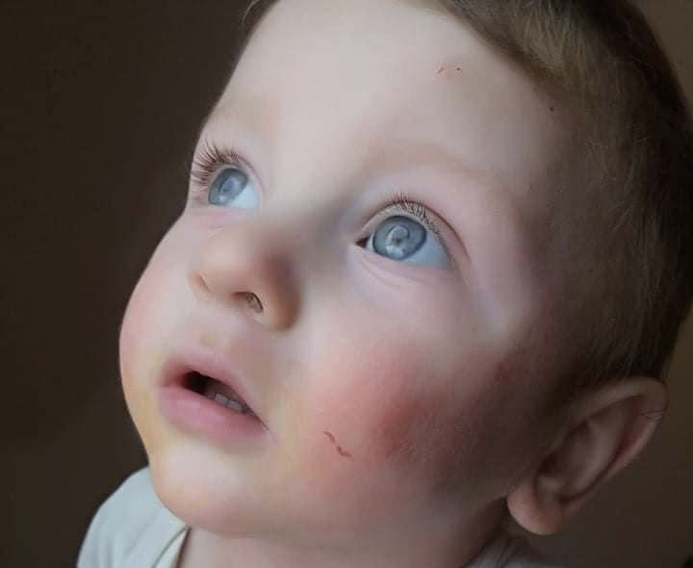
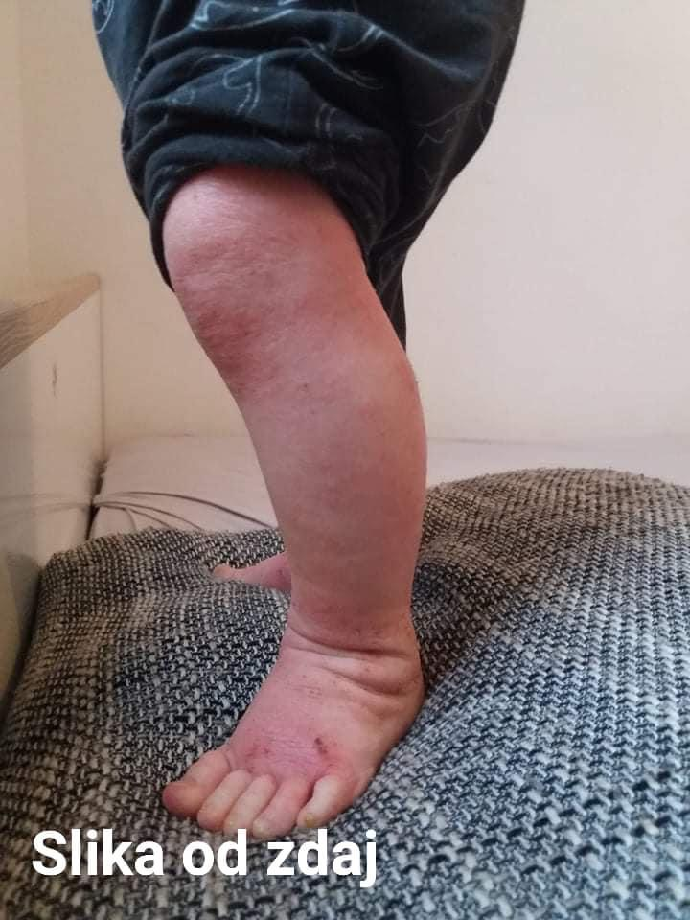
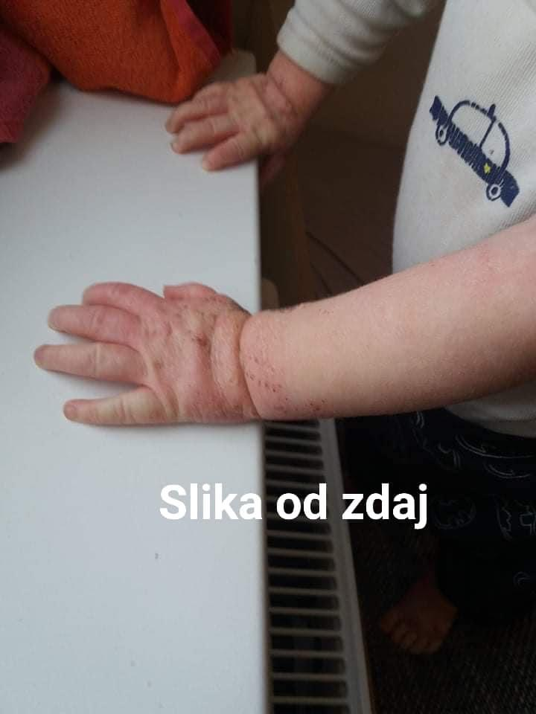
SIX MONTHS into treatment

Slide 25
Results
7 MONTHS AFTER WE STARTED:
Skin was better. But far from what we wanted to achieve.
Testing the microbioma.
In the first R of treatment (Removal of irritants in all forms) pathogenic microorganisms such as yeast, bacteria and parasites must be eradicated. We did a comprehensive stool analysis.
In the first R of the protocol all sorts of stress levels have to be eliminated (parental stress! The Secret Movie! Pay attention who you spend most tome with!!) All is energy!

Slide 26
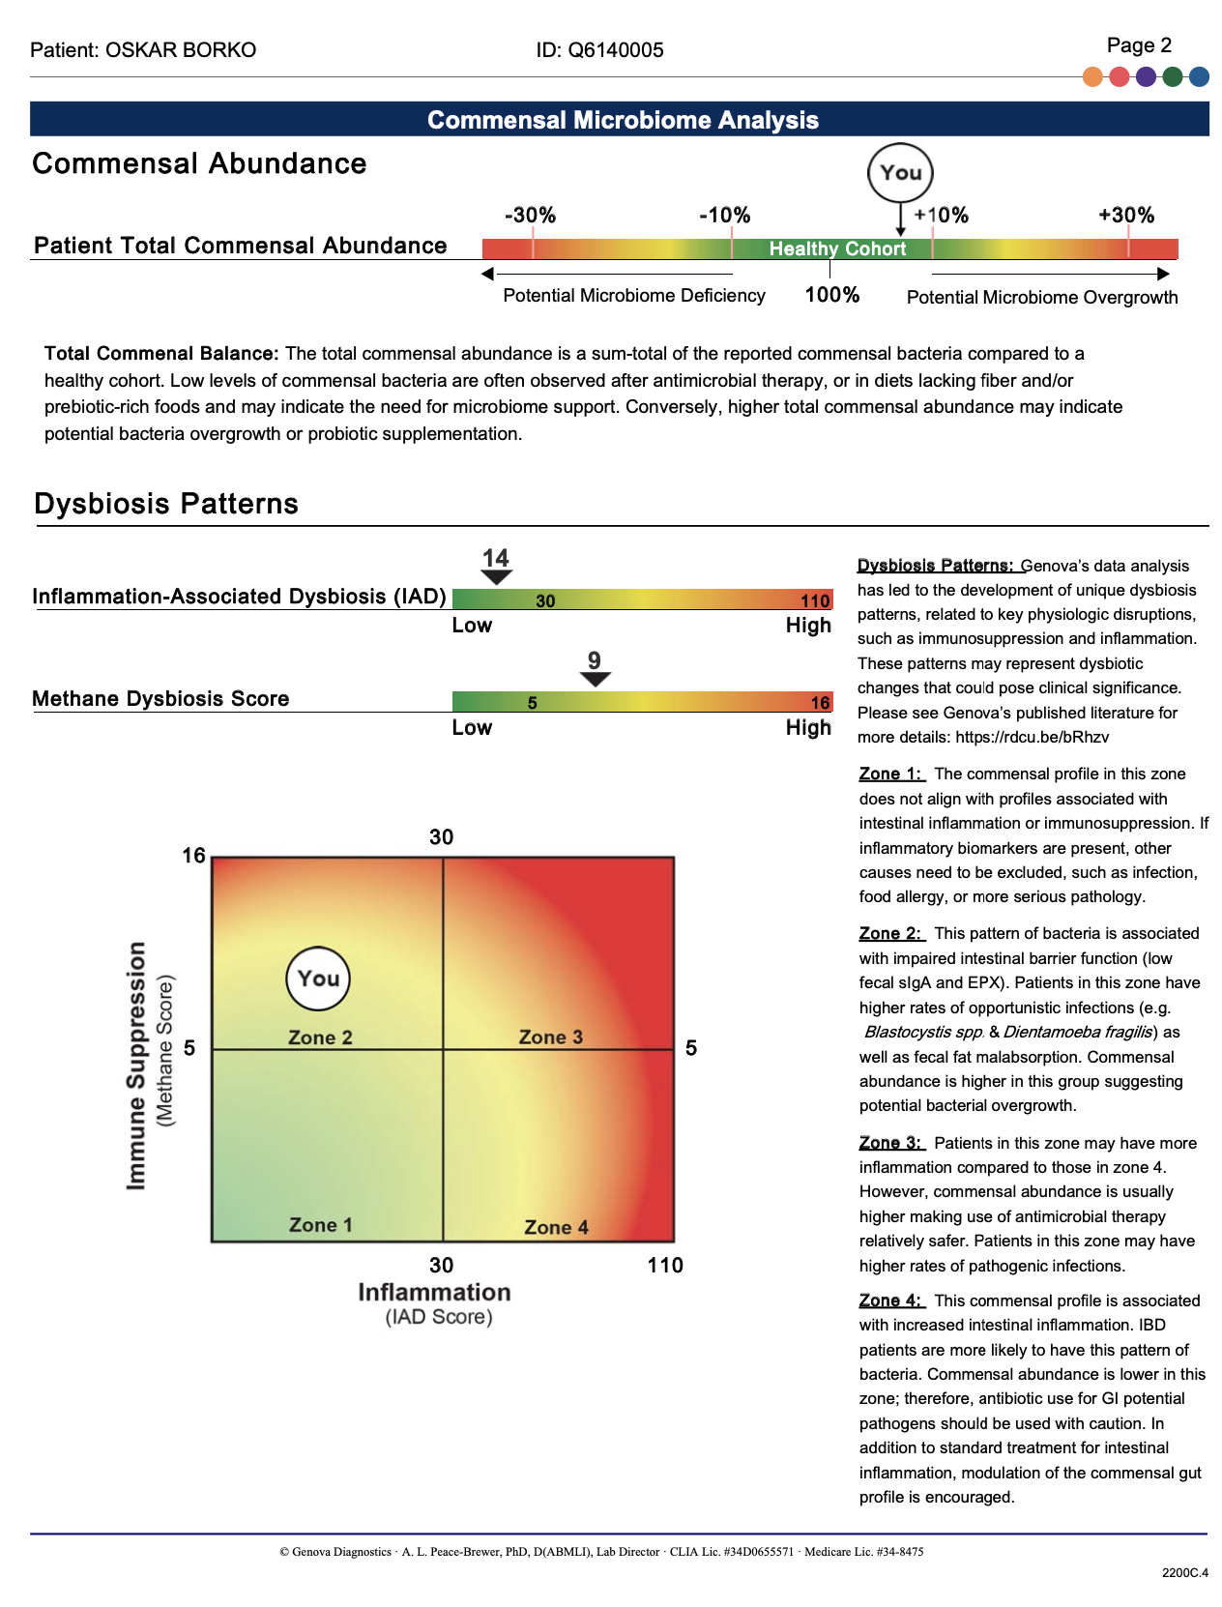
Testing

Slide 27
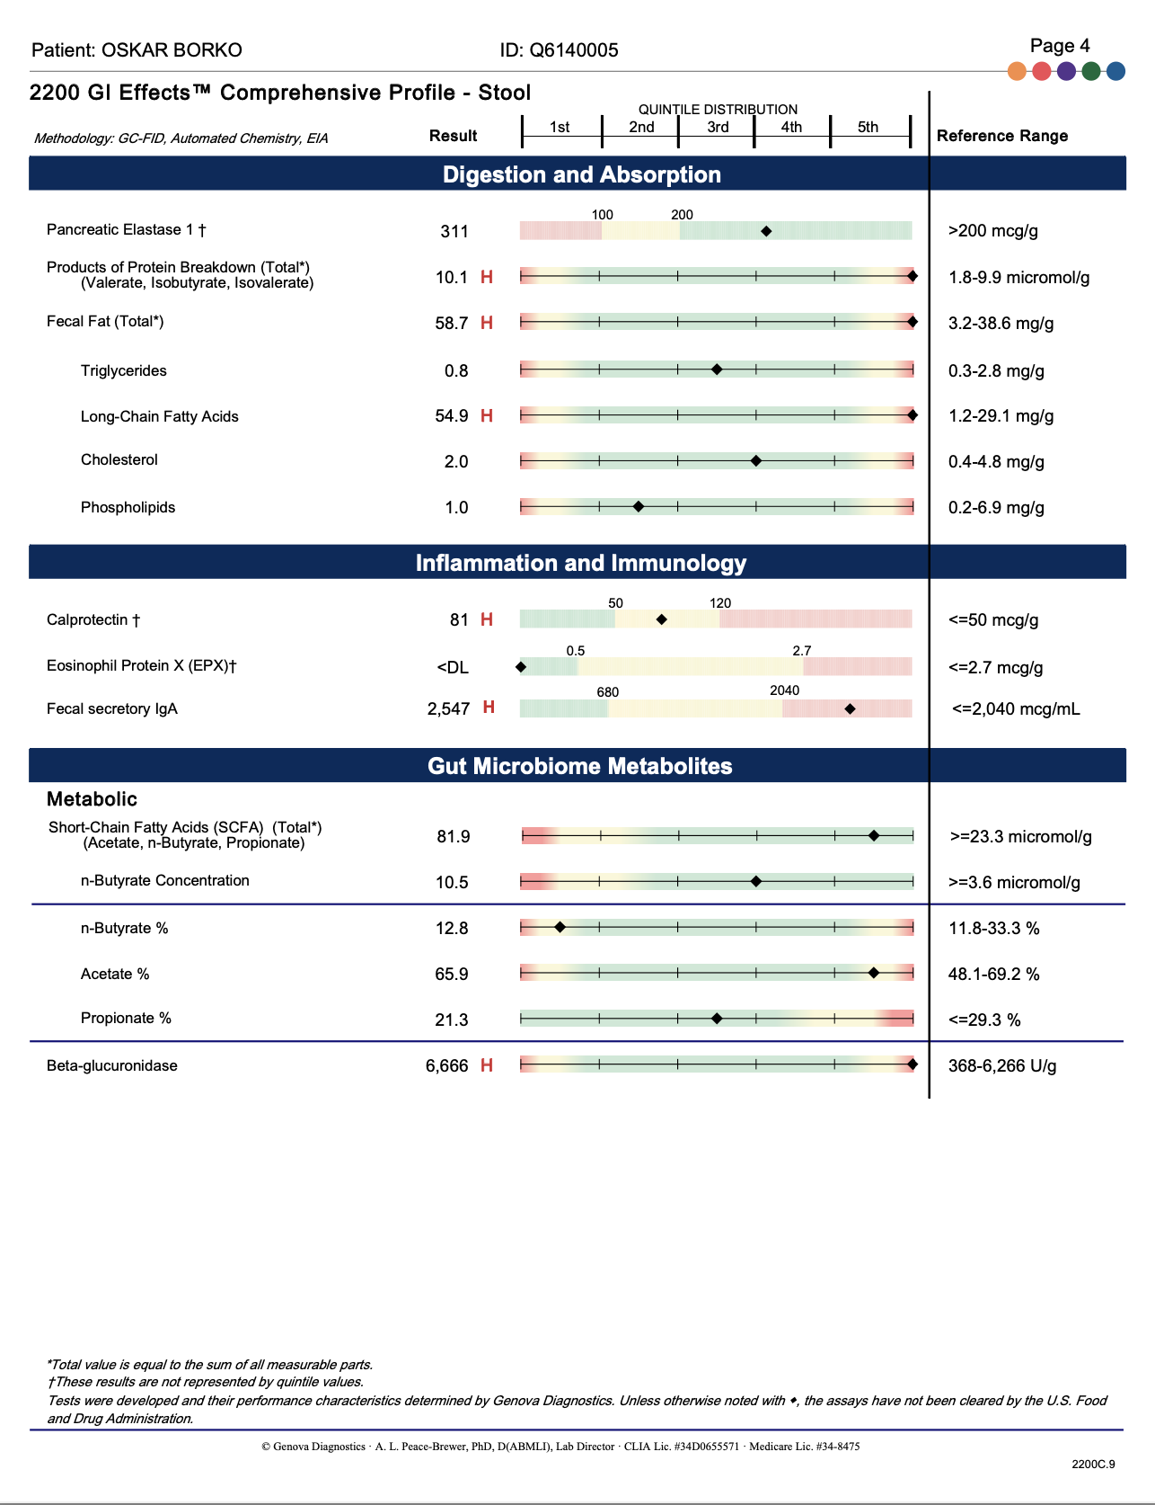
Testing

Slide 28
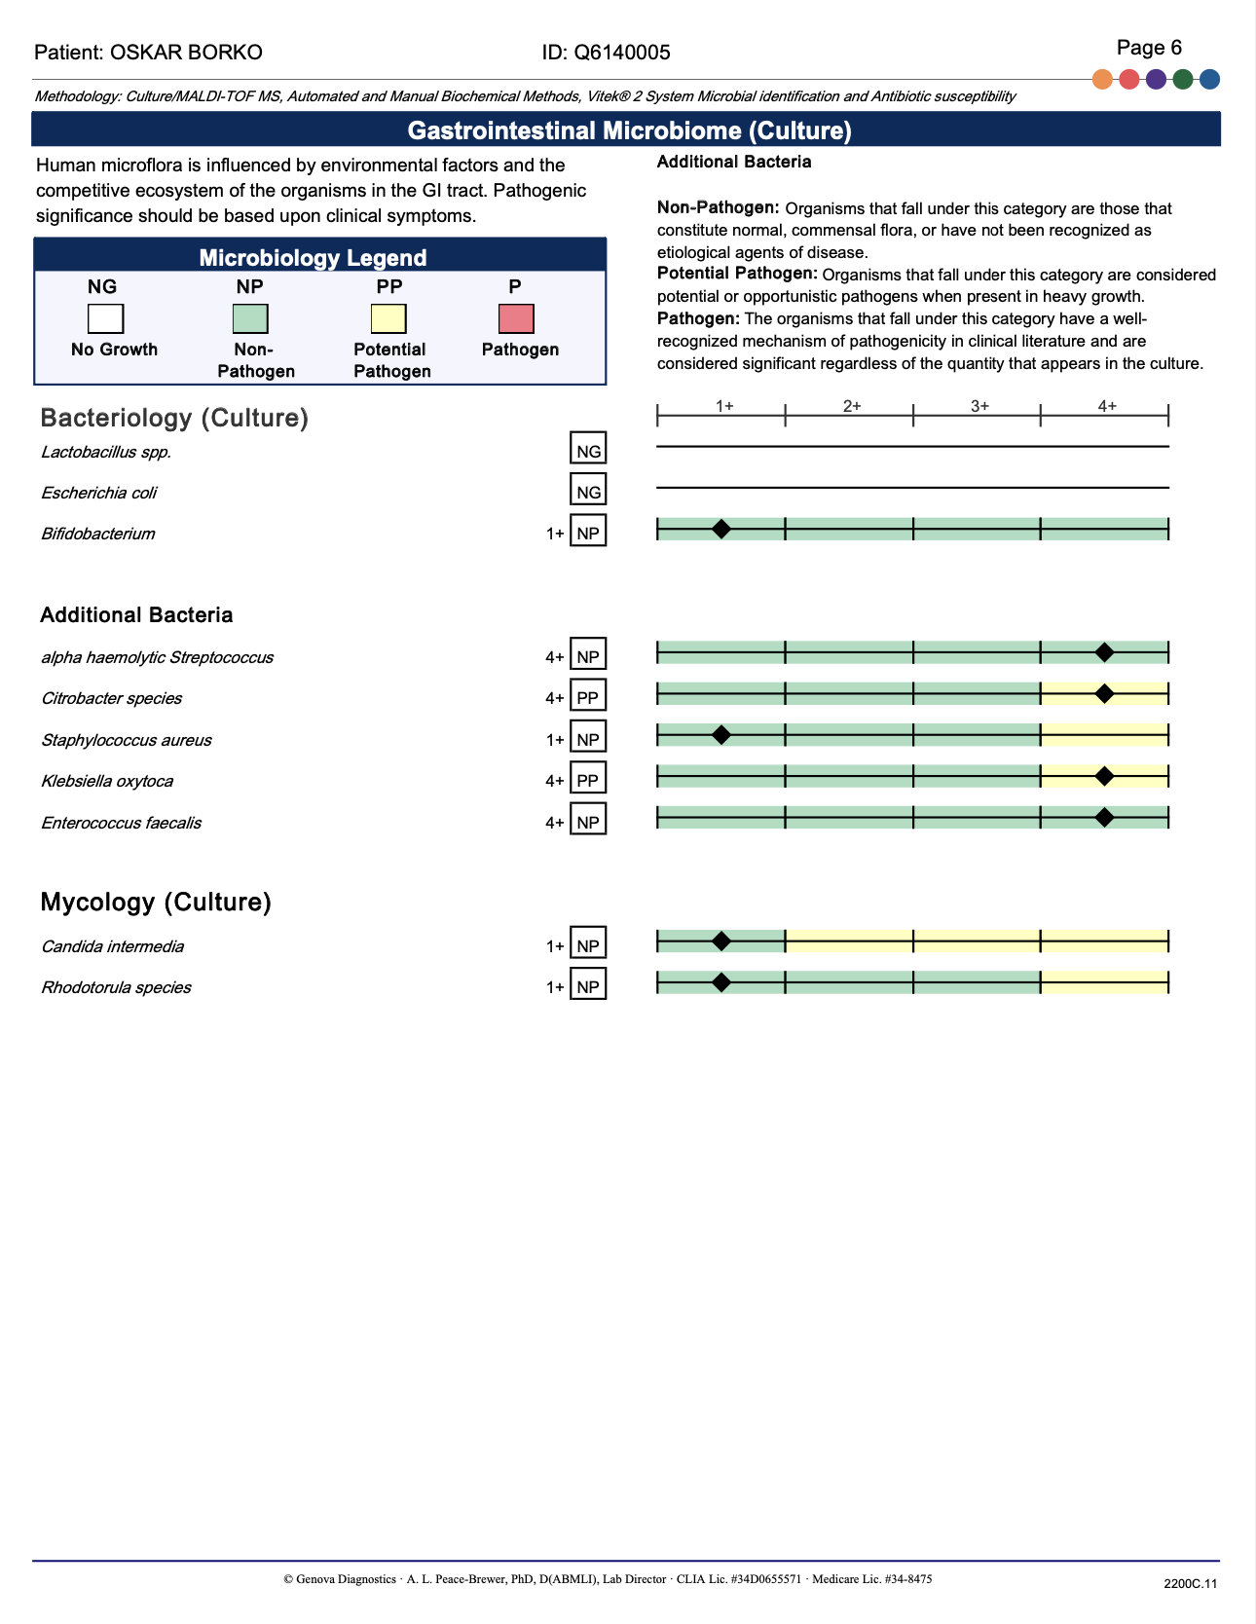
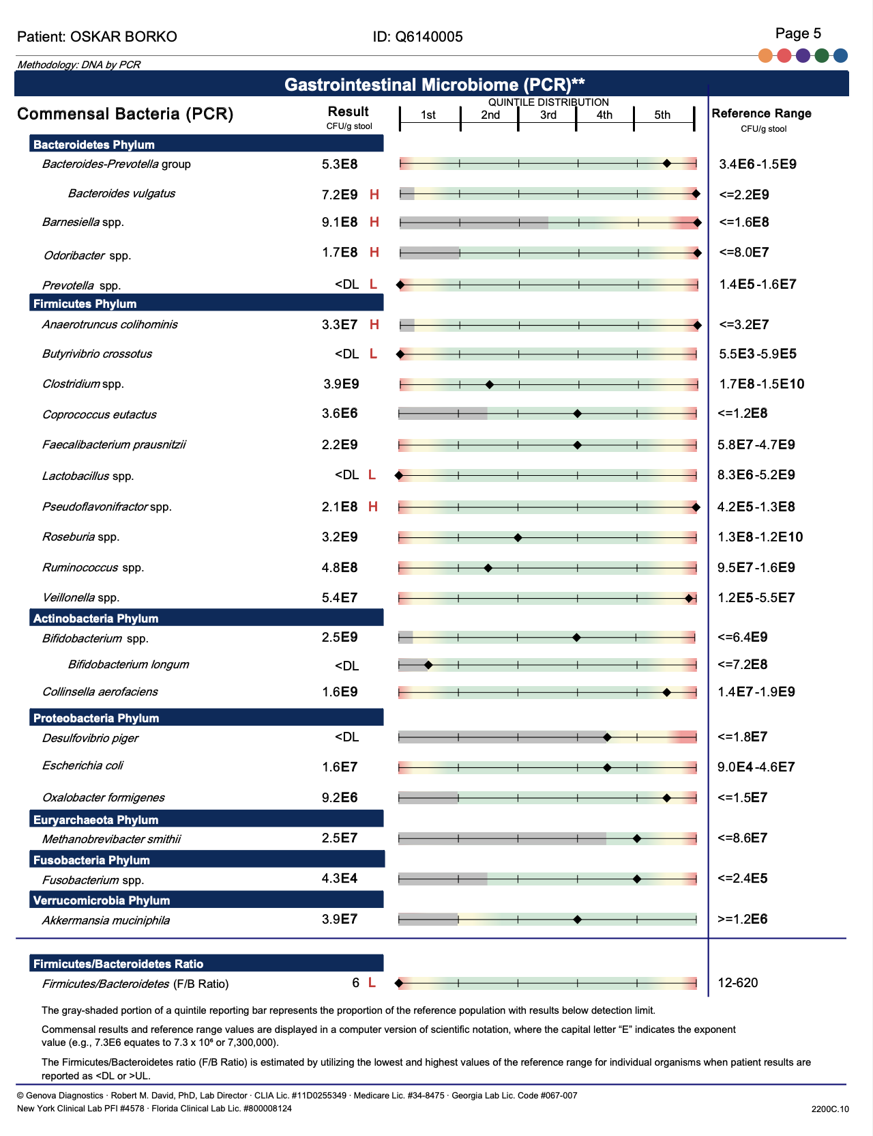
Testing

Slide 29
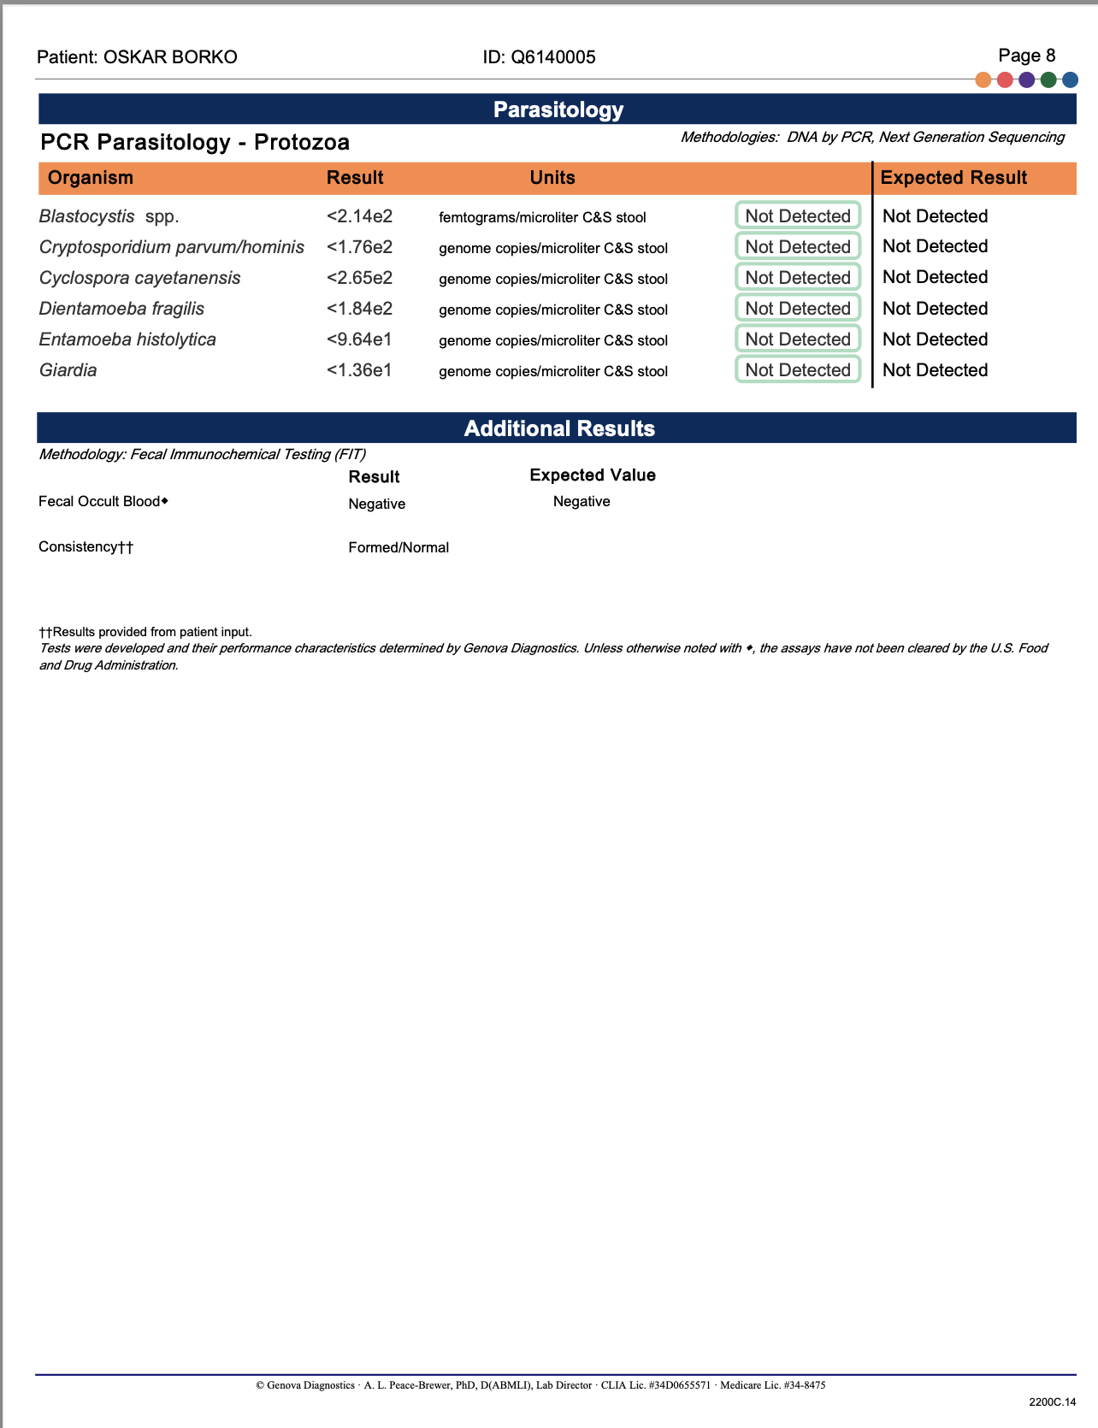
Testing

Slide 30
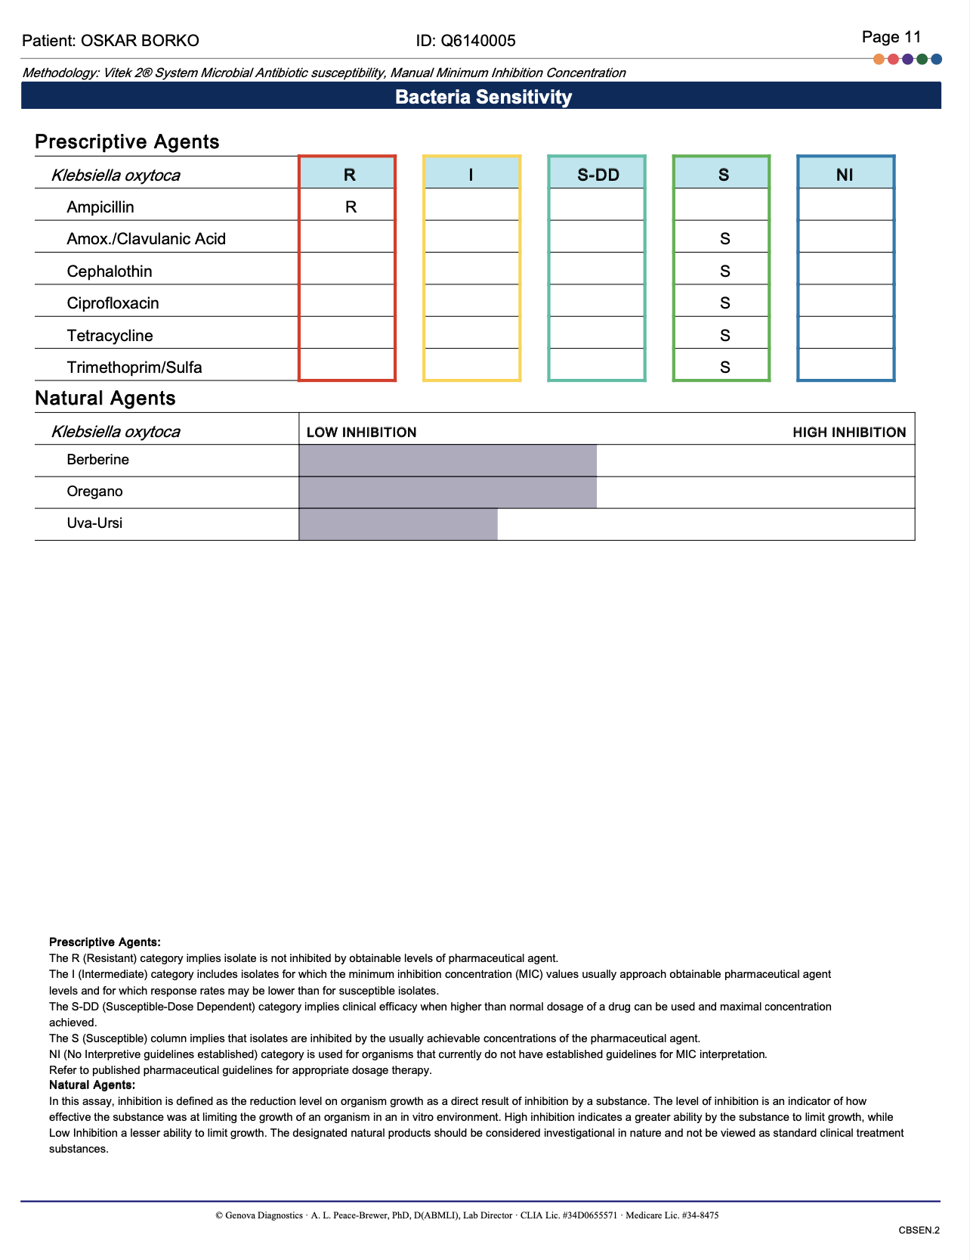
Testing

Slide 31
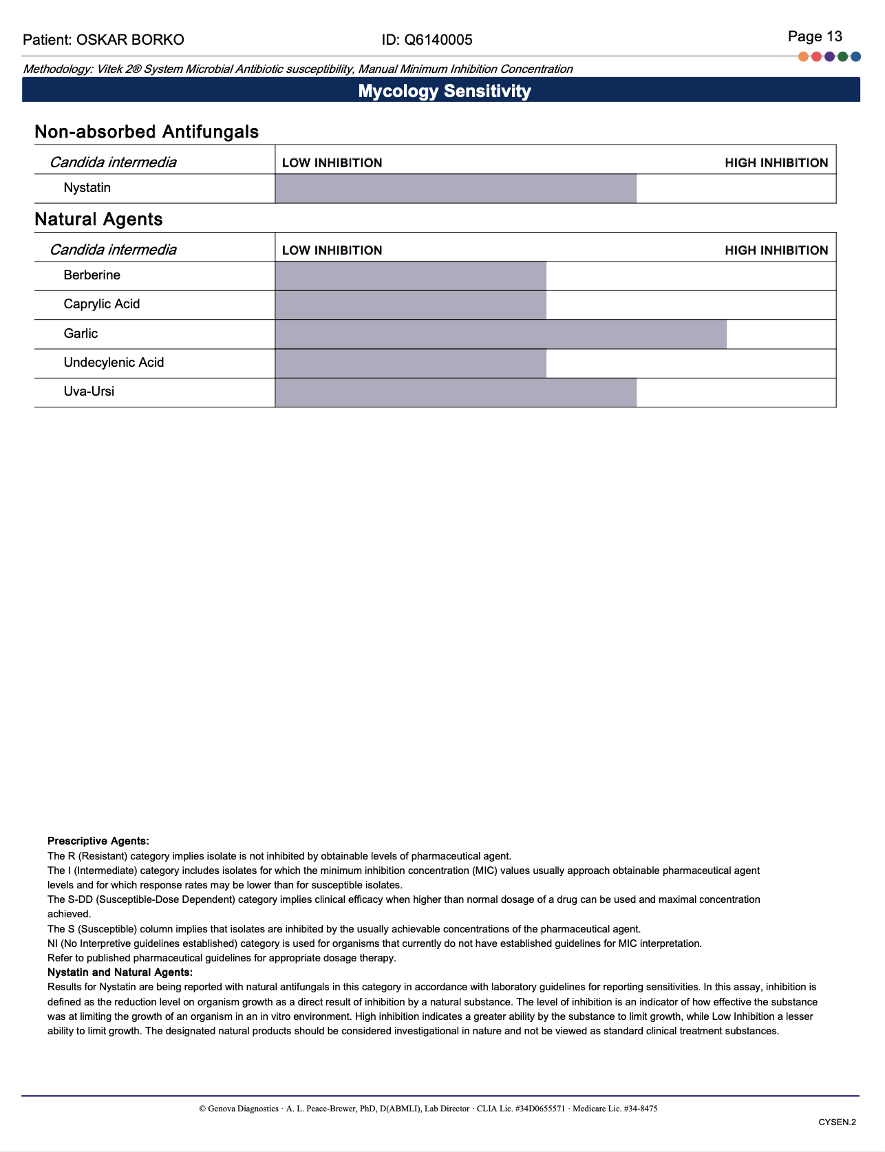
Testing

Slide 32
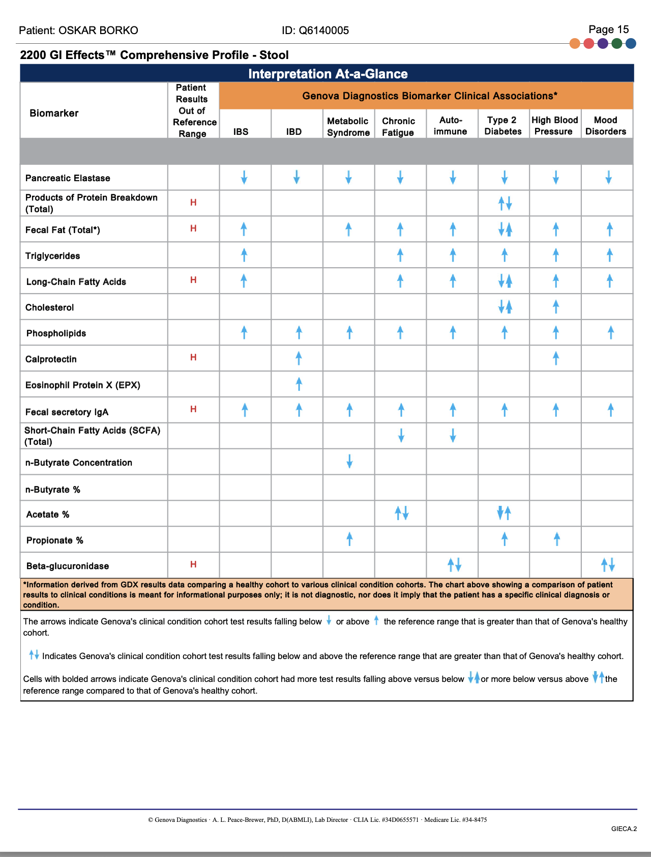
Testing

Slide 33
We personalized the treatment even more
Added PB NO 3 and PB NO4 in small amounts started with 1/4 teaspoon of PB NO3 and increased to 1/2 TS and added a pinch of PB NO4. We increased the dosing of other supplements and added some special herbal treatment dysbiosis treatment, among others we increased the PB No1 he has taken those 3-times daily in very high doses, but we tampered them down to the tolerable dose.
(Images on next slides)

Slide 34
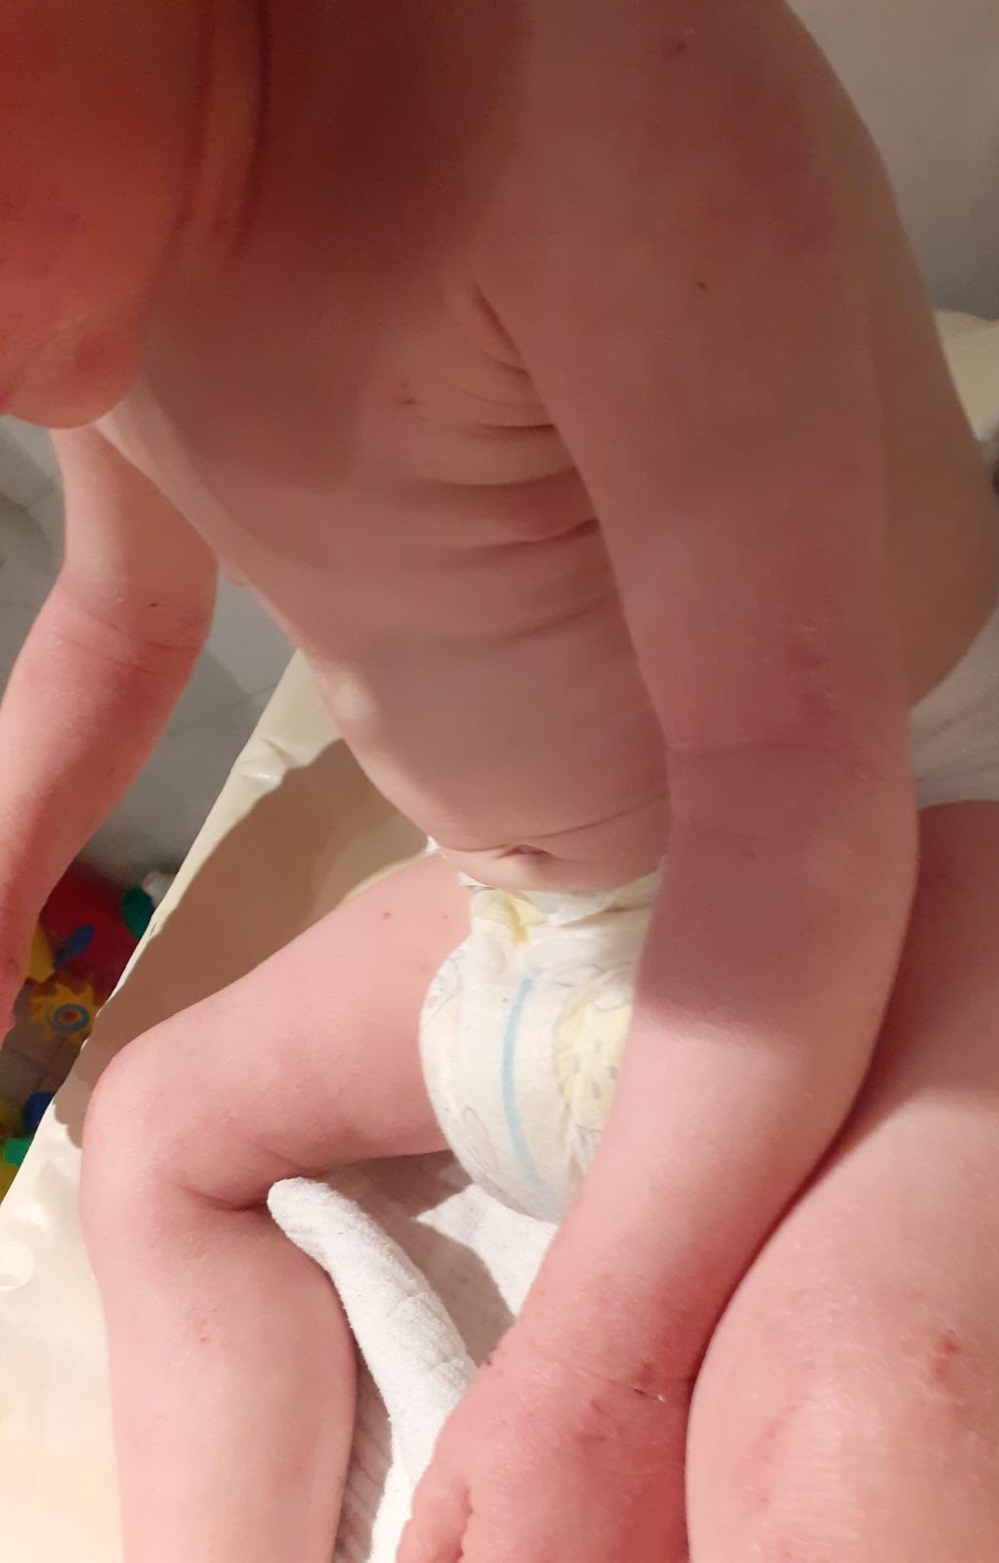
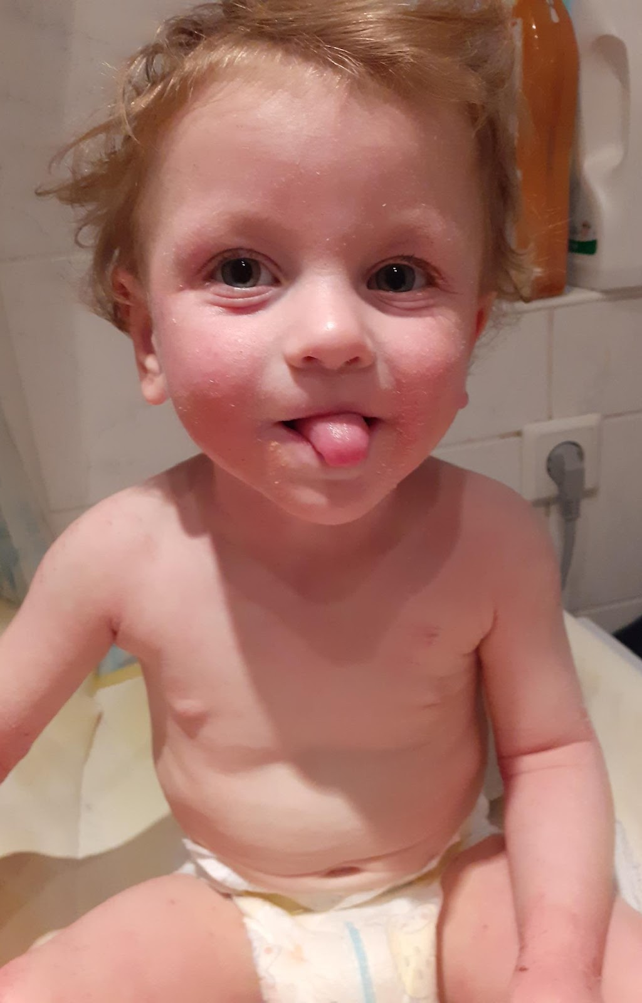
EIGHT MONTHS into Treatment now w/ added microbioma treatment

Slide 35
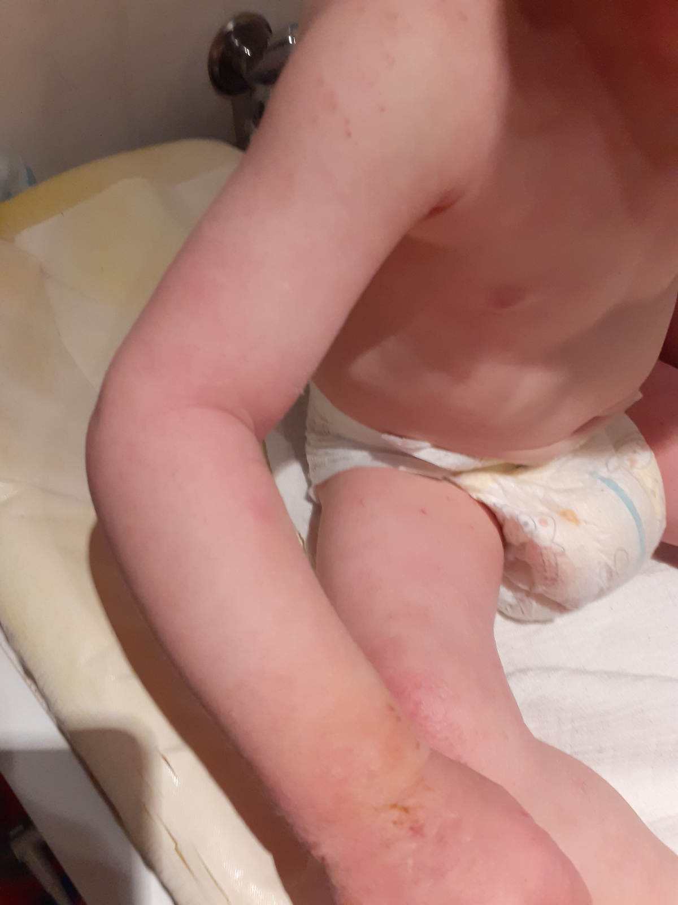
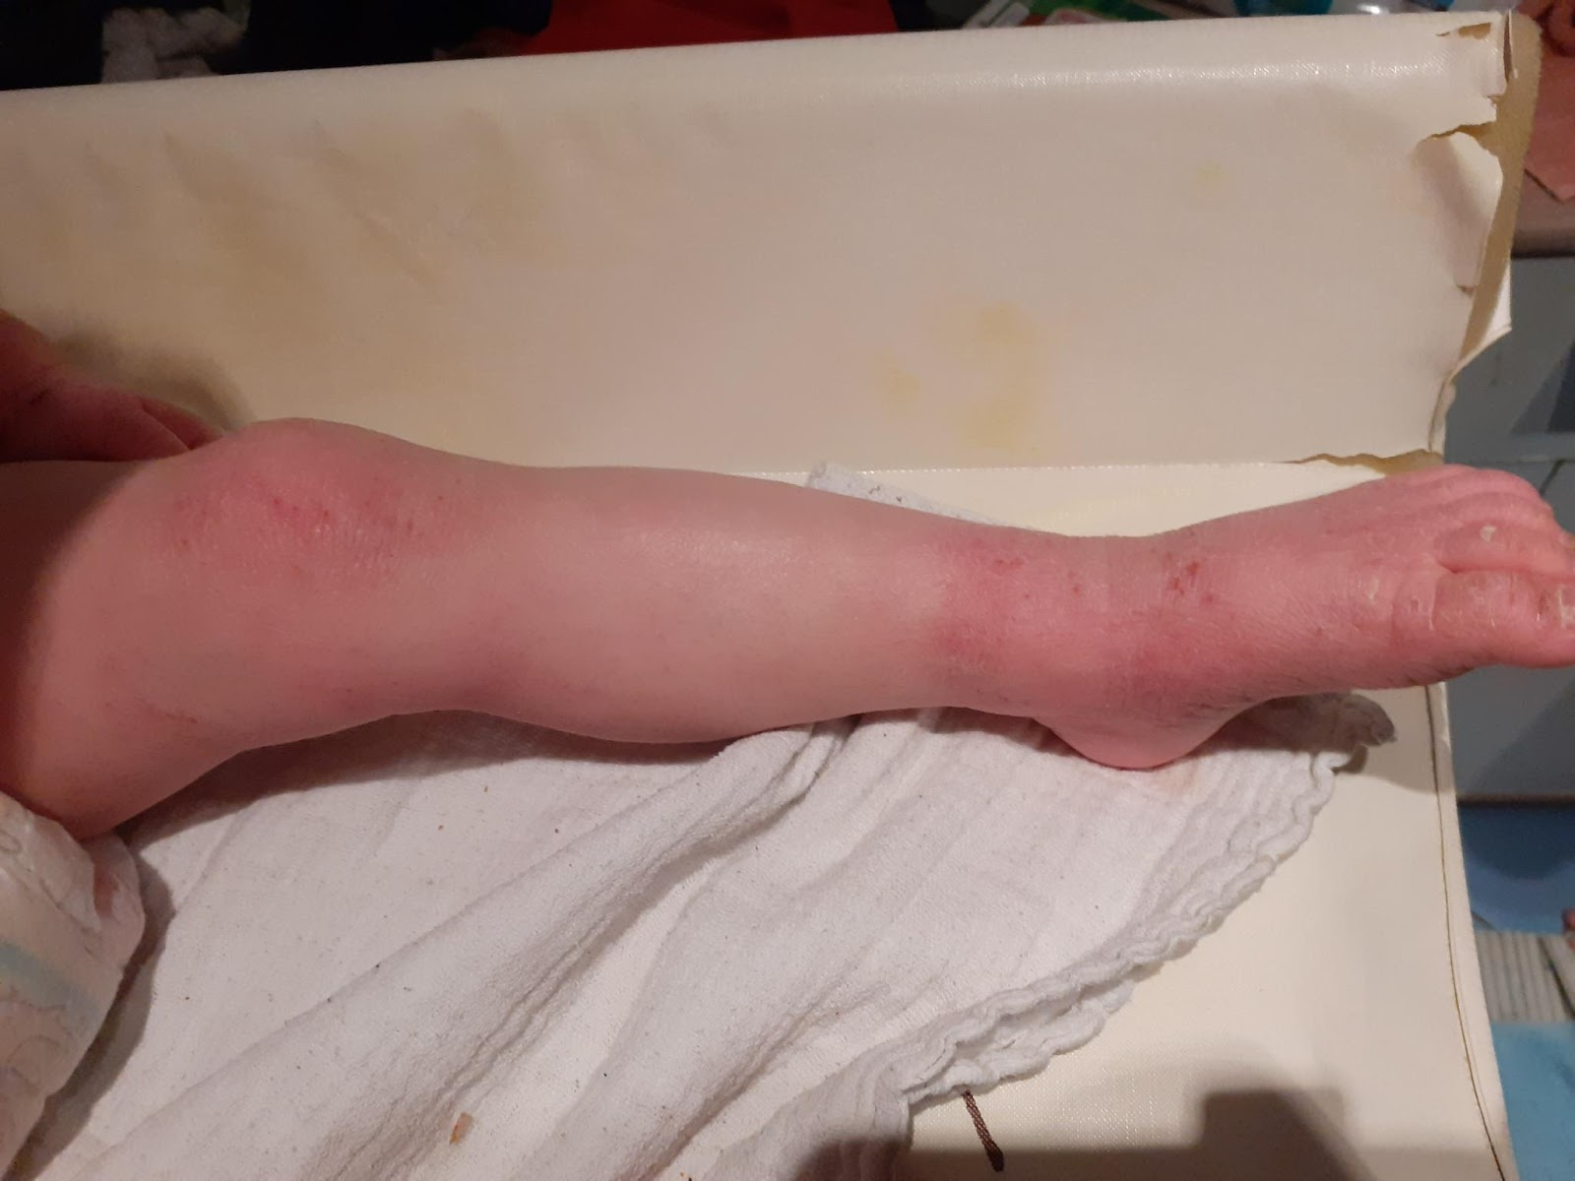
EIGHT MONTHS into Treatment w/ added microbioma treatment

Slide 36
REFERENCES
https://www.ncbi.nlm.nih.gov/pmc/articles/PMC3875841
https://www.ncbi.nlm.nih.gov/labs/pmc/articles/PMC3429124/
https://www.ncbi.nlm.nih.gov/pmc/articles/PMC4303853/
www.ncbi.nlm.nih.gov/books/NBK279399/
pubmed.ncbi.nlm.nih.gov/21913202
pubmed.ncbi.nlm.nih.gov/21727789/
www.jci.org/articles/view/21060
https://www.ncbi.nlm.nih.gov/books/NBK279399/
International Science and Nutrition Society – CURARE CAUSAM – ISNS 2021

Slide 37
THANKS FOR JOINING US TODAY!

